Slide 1
Macromolecules

Slide 2
Macromolecules
Large organic molecules.
Also called POLYMERS.
Made up of smaller “building blocks” called MONOMERS.

Slide 3
The 4 Macromolecules we need to know:
1. Carbohydrates
2. Lipids
3. Proteins
4. Nucleic acids (DNA and RNA)

Slide 4
Organic Compounds
Compounds that contain CARBON are called organic.
Macromolecules are large organic molecules.

Slide 5
Think Pair Share- What are some things you can think of that might be carbohydrates?

Slide 6
Examples:
starch (bread, potatoes)
glycogen (beef muscle)
cellulose (lettuce, corn)

Slide 7
Carbohydrates
Small sugar molecules making up large sugar molecules. Purpose is to give energy and structural support.
Examples:
A. monosaccharide (small)
B. disaccharide
C. polysaccharide (large)

Slide 8
Carbohydrates
Monosaccharide: one sugar unit
(Glucose is a monomer)
Examples: glucose (C₆H₁₂O₆)
glucose

Slide 9
Carbohydrates
Disaccharide: two sugar unit
Examples:
Sucrose (glucose+fructose)
glucose
glucose

Slide 10
Carbohydrates
Polysaccharide: many sugar units
glucose
glucose
glucose
glucose
cellulose
glucose
glucose
glucose
glucose

Slide 11
Think Pair Share- What are some real life examples of lipids or fats?

Slide 12
Lipids
“stores the most energy”
Examples: 1. Fats
2. Phospholipids
3. Oils
4. Waxes
5. Steroid hormones
6. Triglycerides

Slide 13
Lipids
There are two kinds of fatty acids you may see these on food labels- LONG CHAINS OF CARBONS AND HYDROGENS
1. Saturated fatty acids: no double bonds (bad) Examples, bacon, butter.
2. Unsaturated fatty acids: double bonds (good) Examples, vegetable oil, olive oil

Slide 14
Fatty Acids
O
C-CH₂-CH₂-CH₂-CH₂-CH₂-CH₂-CH₂-CH₂-CH₂-CH₃
=
saturated
O
C-CH₂-CH₂-CH₂-CH
unsaturated
=
=CH-CH₂-CH₂-CH₂-CH₂-CH₃

Slide 15
Phospholipids
Make up the cell membrane.
They are made of a hydrophobic tails and a hydrophilic heads.
They can line up and form the lipid bilayer of the cell membrane.
There are proteins and other molecules imbedded in this membrane.

Slide 16
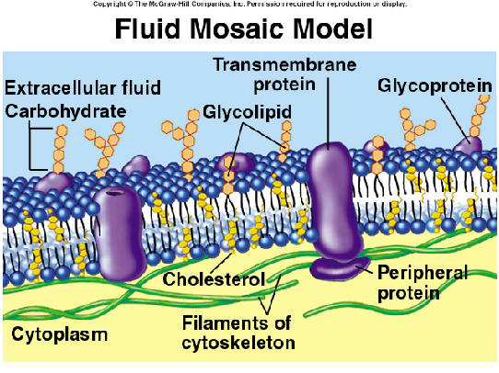
: | JPG

Slide 17
Hydrophobic- HATES water
Hydrophilic- LOVES water

Slide 18
Why are lipids considered to be mostly hydrophobic?

Slide 19
Other Lipids
There are other lipids that don’t fit into the 1st 3 groups. Examples:
Wax
Pigments (chlorophyll)
Sterols (Steroids)
Cholesterols

Slide 20
Six functions of lipids:
1. Long term energy storage
2. Protection against heat loss (insulation)
3. Protection against physical shock
4. Protection against water loss
5. Chemical messengers (hormones)
6. Major component of membranes (phospholipids)

Slide 21
Think Pair Share- What are some real life examples of Proteins?

Slide 22
Proteins
Made up of Amino acids (20 different kinds) which are bonded together by peptide bonds (polypeptides). They are the building blocks.

Slide 23
Proteins
Four levels of protein structure:
A. Primary Structure
B. Secondary Structure
C. Tertiary Structure
D. Quaternary Structure

Slide 24
Primary Structure
Amino acids bonded together by peptide bonds (straight chains)
Amino Acids (aa)
aa1
aa2
aa3
aa4
aa5
aa6
Peptide Bonds

Slide 25
Secondary Structure
3-dimensional folding arrangement of a primary structure into coils and pleats held together by hydrogen bonds.
Alpha Helix
Beta Pleated Sheet
Hydrogen Bonds

Slide 26
Tertiary Structure
Secondary structures bent and folded into a more complex 3-D arrangement of joined polypeptides
Bonds: H-bonds, ionic, disulfide bridges (S-S)
Call a “subunit”.
Alpha Helix
Beta Pleated Sheet

Slide 27
Quaternary Structure
Composed of 2 or more “subunits”
Globular in shape
Form in Aqueous environments
Example: enzymes (hemoglobin)
subunits

Slide 28
Nucleic Acids

Slide 29
Nucleic acids
Two types:
a. Deoxyribonucleic acid (DNA- double helix) Stores Hereditary information
b. Ribonucleic acid (RNA-single strand)
Nucleic acids are composed of long chains of nucleotides.

Slide 30
Nucleotide
Phosphate
Group
O
O=P-O
O
5
CH2
O
N
Nitrogenous base
(A, G, C, or T)
C⁴
C¹
Sugar
(deoxyribose)
C³
C²

Slide 31
DNA - double helix
5
O
3
3
O
P
5
P
5
O
G
C
1
2
3
4
4
2
1
3
5
P
O
P
T
A
3
5
O
O
5
P
P
3

Slide 32
Take out a ½ sheet of paper and make a line down the middle. On one side write down things you get about macromolecules, on the other side write down things you are still confused about.

