Slide 1
Mammals of Minnesota
Environmental Science
Wildlife Biology & Conservation

Slide 2
Mammals
Characteristics
Usually have fur
Give live birth (2 mammals lay eggs)
Can you name them?
Have mammary glands for feeding young milk
Warm blooded (endothermy)
4 chambered heart

Slide 3
Monotremes-Egg laying mammals

Slide 4
Arctic Shrew
Sorex arcticus
Mostly gray, white belly. 4” long head to tail.
Tamarack and spruce swamps
Insects and other invertebrates.

Slide 5
Big Brown Bat
Eptesicus fuscus
Pale to dark brown. About 6” wingspan
Caves, tunnels, hallow trees, wooded areas.
Insects, usually beetles

Slide 6
Black Bear
Ursus americanus
5-6’ long, 2-3’ tall.
Weigh up to 500lbs
Black, cinnamon, white
Forests and swamps
Berries, nuts, honey, insects, eggs, small mammals, garbage
Smallest, most common bear

Slide 7
Raccoon
Procyon lotor
18-28”, 12-35lbs
Black mask over eyes
Tail rings
Along streams and lake borders near wooded areas.
Fruit, nuts, insects frogs, bird eggs.

Slide 8
Least Weasel
Mustela rixosa
6’ head and body
Usually brown with white belly.
Meadows, fields, open woods
Mice
Smallest living carnivore

Slide 9
Fisher
Martes pennanti
Dark brown with white tipped hairs (looks frosted)
Cutover areas, mixed hardwood forests
Small mammals, birds, fruits, fern tips.

Slide 10
Mink
Mustela vision
Dark brown with white chin patch
Along streams and lakes
Sm mammals, birds, eggs, frogs, fish.

Slide 11
River Otter
Lutra canadensis
10-25lbs
Rich brown above, silvery sheen below, webbed feet, brown snout.
Along streams and lake borders
Fish, frogs, crayfish, invertebrates.
Social & Curious: Usually 2 or more individuals together

Slide 12
Striped Skunk
Mephitis mephitis
Black body with narrow stripe that splits down the back.
Semi open country, mixed woods, brushland, open prairie
Mice, eggs, insects, berries.

Slide 13
American Badger
Taxidea taxus
Yellowish-gray, median which strip over head, white cheeks, black feet.
Open grassland and desert
Small rodent
Great digger, lives in a den.

Slide 14
Red Fox
Vulpes fulva
Reddish-yellow, white belly, bushy tail, with white tip.
Mixture of forest and open areas.
Insects, hares, berries, fruit, mice
Female is called a vixen.

Slide 15
Coyote
Canis latrans
Gray or reddish gray with rusty legs, feet, ears. Throat and belly whitish.
20-50 lbs
Prairies, open woods, brushy areas.
Eats almost anything.
Dens in ground.

Slide 16
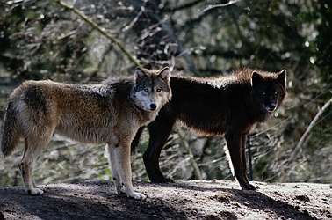
Timberwolf (Gray Wolf)
Canis lupus
70-120 lbs
Color varies from nearly white to nearly black.
Wilderness forests and tundra
Eat anything available-birds, deer, caribou
Pack animal

Slide 17
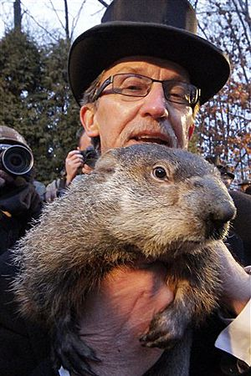
Woodchuck
Marmota monax
Heavy bodied, short-legged, yellowish brown, hairs look frosted, black feet, white around nose.
Open woods, brushy/rocky ravines
Plants
AKA groundhog

Slide 18
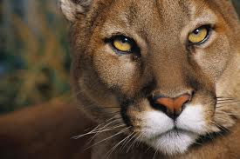
Mountain Lion (Puma, Cougar)
Felis concolor
Tawny to grayish cat with dark brown on tip of its long tail. Greenish gold eyes.
Rugged mountains, forests, swamps.
Deer, rodents, domestic animals.
Seldom seen. Rare in midwest.

Slide 19
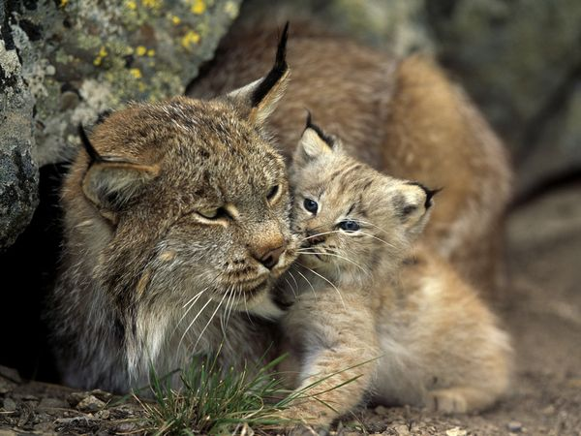
Lynx
Lynx canadensis
Short tail with completely black tip and tufted ears. 15-30lbs
Forested areas, swamps
Snowshoe hare, rodents, birds
Large feet for its size, to walk on top of snow.

Slide 20
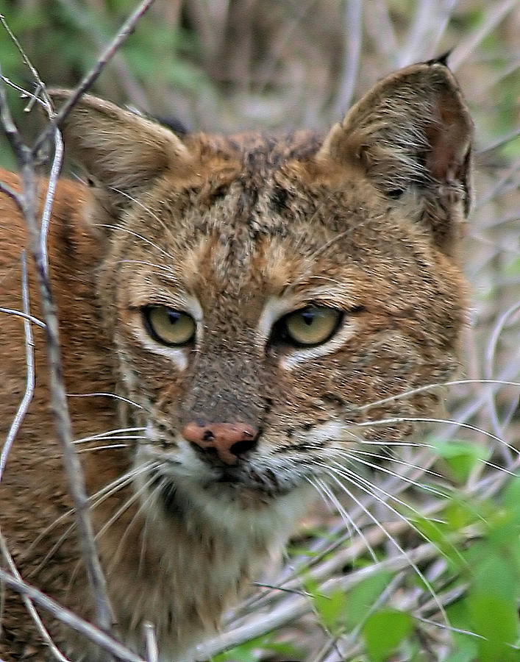
Bobcat
Lynx rufus
Short tail black only on the tip, short ear tufts.
Swamps and forests
Small mammals and birds.

Slide 21
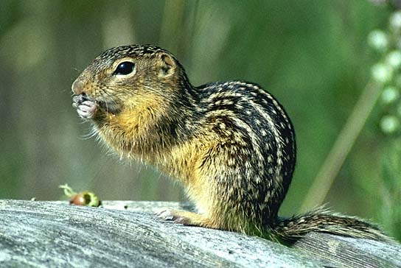
Thirteen Line Ground Squirrel
Citellus tridecemlineatus
13 whitish stripes on sides and back, some broken into a rows of spots.
Shortgrass praries, golf courses
Seeds insects, occasionally meat.
Hibernates for 6 months (Oct-Mar)

Slide 23
Eastern Chipmunk
Tamias striatus
Facial stripes, side and back stripes end at reddish rump.
Deciduous forest
Seeds, bulbs, fruits, nuts.
Very territorial

Slide 24
Gray Squirrel
Sciurus carolinensis
Grayish color, very bushy tail with white-tipped hairs.
Hardwood forests, river bottoms.
Nuts, seeds, fungi, fruits, bark.
Help in reforestation.

Slide 25
Red Squirrel
Tamiasciurus hudsonicus
Yellowish or reddish, black line along side, whitish belly.
Pine or mixed forests, swamps.
seeds, nuts, eggs, fungi
Noisy
Stores food in chaches

Slide 26
Eastern Fox Squirrel
Sciurus niger
Rusty yellowish with pale yellow/orange belly, bushy tail with tawny tipped hairs.
Open hardwoods, pine forests
nuts, acorns, seeds, bird eggs
burries nuts singly: many are not retrieved.

Slide 27
Plains Pocket Gopher
Geomys bursarius
Yellowish to brown, spotted and albino versions.
Grassland, alfalfa fields, pastures.

Slide 28
Beaver
Castor canadensis
Rich brown color, paddle-shaped scaly tail (6" wide)
Streams and lakes with trees on banks
bark and small twigs
Changes its ecosystem-makes dam and lodge.

Slide 29
Muskrat
Ondatra zibethica
Rich brown fur, silvery belly, black scaly tail.
Marshes, edges of ponds, lakes, streams
Aquatic vegetation, clams, frogs, fish
One of the most valuable fur animals.

Slide 30
Eastern Cottontail
Sylvilagus floridanus
Brownish or grayish, cottony white tail, nape patch rusty, whitish feet.
Heavy brush, forests with open areas, swamp edges, weed patches.
green vegetation, bark twigs
Damages gardens

Slide 31
White-tailed Deer
Odocoileus virginianus
Large white-flag tail, Reddish in summer, grayish in winter.
Forests, swamps, open brushy areas.
twigs, shrubs, fungi, acorns, grass, herbs
The rut-breeding season.
lose antlers yearly

Slide 32
House Mouse
Mus musculus
Grayish brown with gray or buff belly, scaly tail
Fields, inside buildings
anything edible
breed year round

