Slide 1
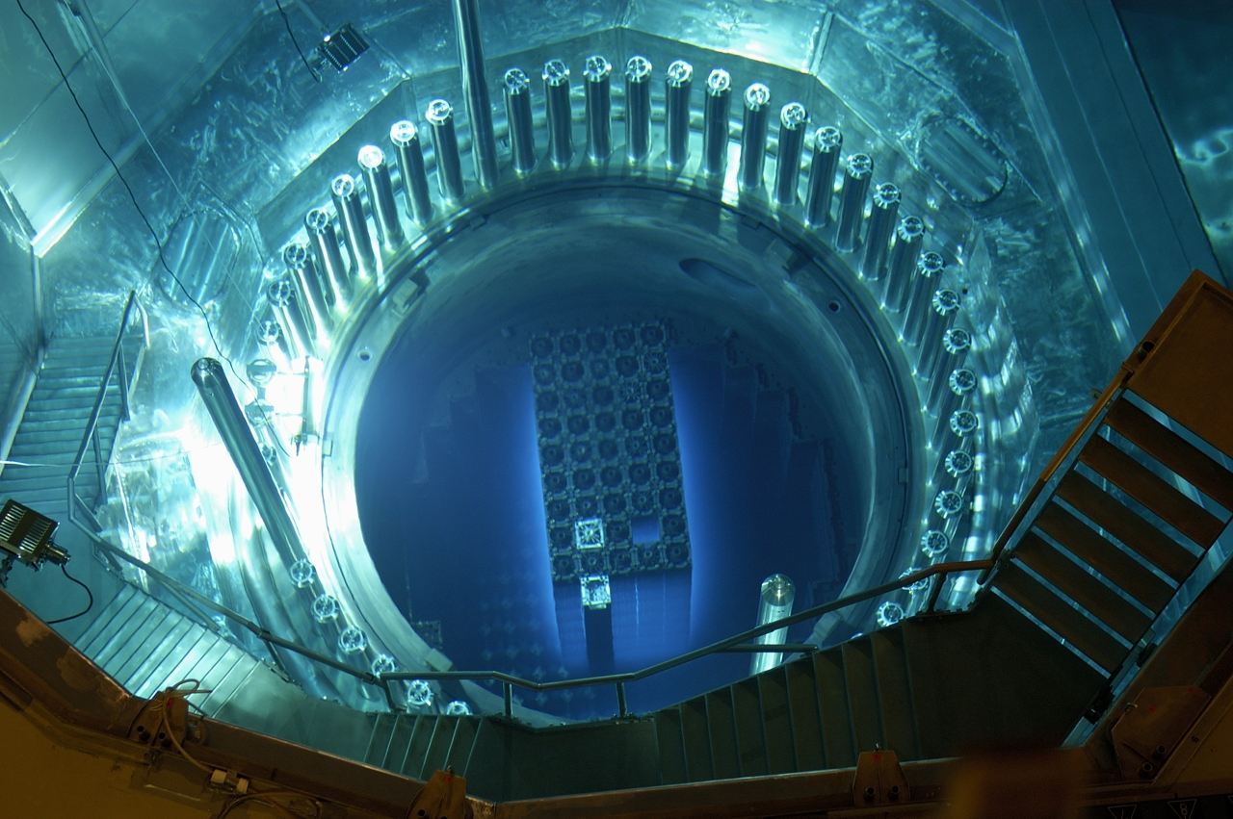
Energy
“You are meddling with forces you cannot possibly comprehend.”
- Marcus, Indiana Jones and the Last Crusade

Slide 2
How Is Electricity Generated?
An electric generator is a device that converts mechanical energy into electrical energy through a turbine.
Fuel is burned to heat water into steam.
A turbine is a wheel that changes the force of the steam into energy.
The energy from the turbine spins a generator to produce electricity.

Slide 3
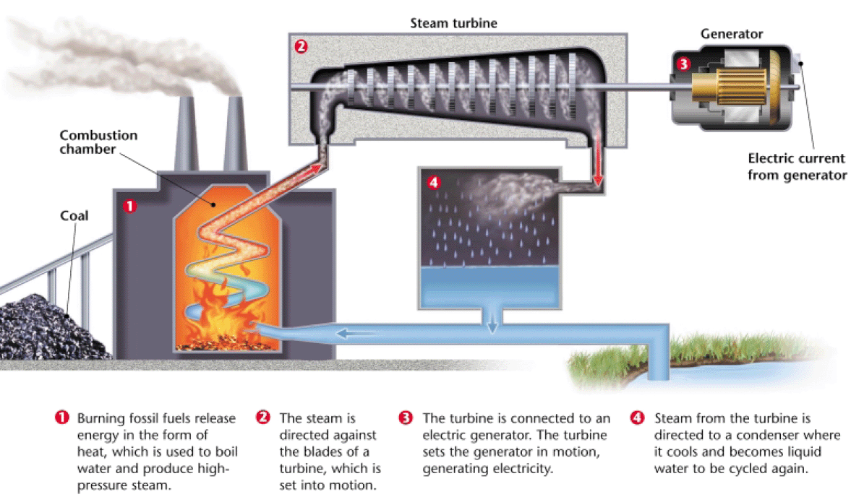
How Is Electricity Generated?

Slide 4
Current Energy Sources
Fossil Fuels currently provide about 85% of all commercial energy in the world.
Other renewable sources (wind, solar, hydroelectric) make up 9% of commercial power.
Nuclear power makes up 6% of commercial power.

Slide 5
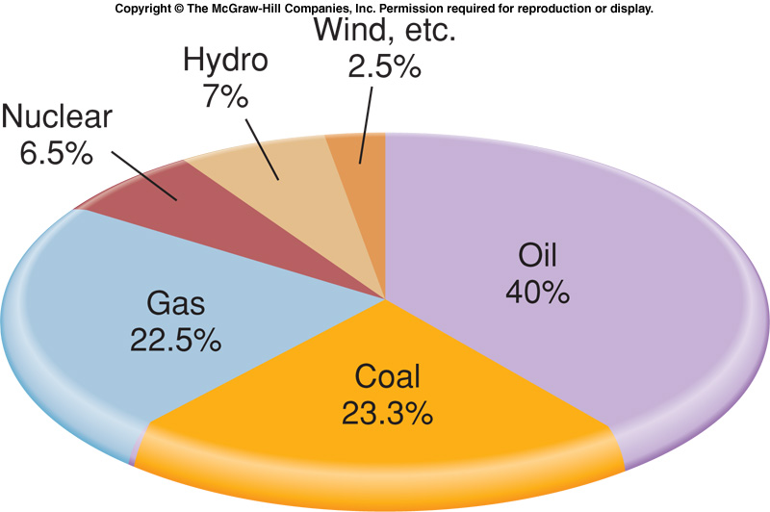
Worldwide Commercial Energy Production

Slide 6
Per Capita Consumption
Richest 20 countries consume nearly 80% of natural gas, 65% of oil, and 50% of coal production annually.
On average, each person in the U.S. and Canada uses more than 300 GJ of energy annually.
In poorest countries of the world, each person generally consumes less than one GJ annually.

Slide 7
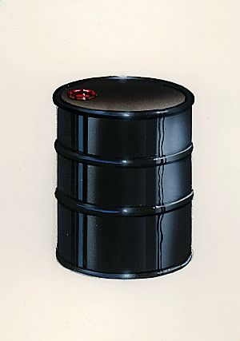
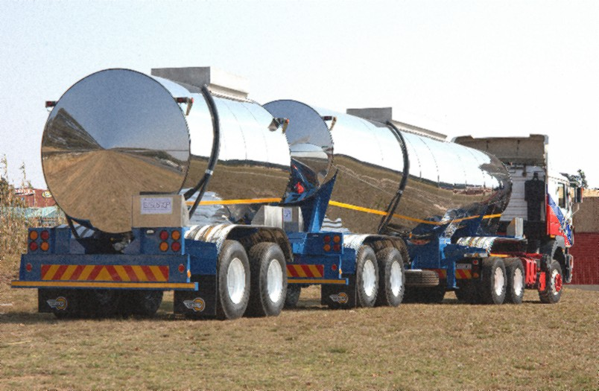
What is a Gigajoule?
One gigajoule =
Three hundred
gigajoules =

Slide 8
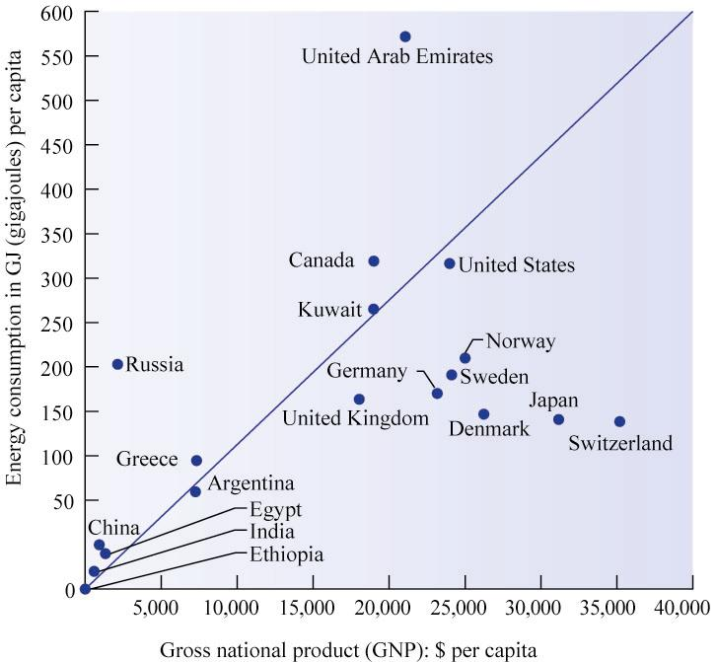
Per Capita Energy Use

Slide 9
How Energy is Used
Largest share of energy used in the U.S. is consumed by industry (32.6%).
Residential and Commercial buildings use 37.6% of primary energy consumed in U.S.
Transportation consumes about 26% of all energy used in the U.S.
Three trillion passenger miles and 600 billion ton miles of freight carried annually by motor vehicles in the U.S.

Slide 10
How Energy Is Used Cont’d
Electricity generation is very inefficient.
About half of all energy in primary fuels is lost by the time the electricity is actually used:
Coal power plants are only about 30% efficient.
About 10% is lost during transmission across the power lines.
More power is wasted by the appliance itself.

Slide 11
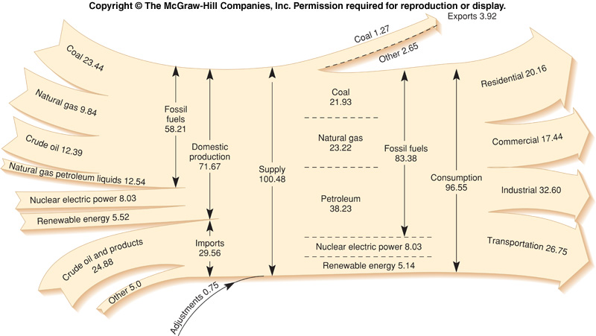
Figure 12.03

Slide 12
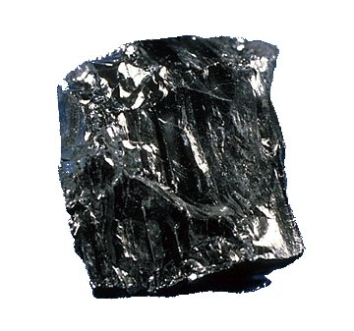
Coal

Slide 13
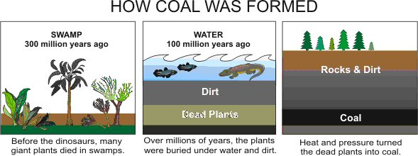
COAL
Coal
Mainly made of carbon, but also contains sulfur, hydrogen, oxygen, and nitrogen.
Created by the accumulation of plant matter over thousands of years.

Slide 14
COAL
Early Uses
Coal has been used as an energy source dating as far back as 400 A.D. in Rome.
Used as an alternative to wood, because the forests were mostly clear-cut around the city.
Demand increased during the industrial revolution, when the steam engine was invented.

Slide 15
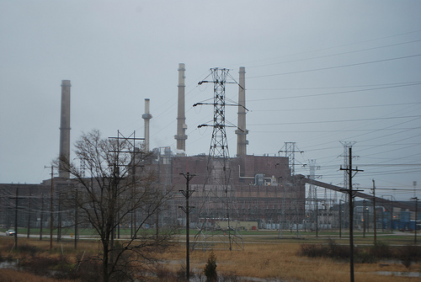
COAL
Midwest Generation Coal-Fired Power Plant, Waukegan, IL
Lake County’s biggest producer of carbon monoxide, nitrogen oxides, sulfur dioxides, and particulates....and electricity.

Slide 16
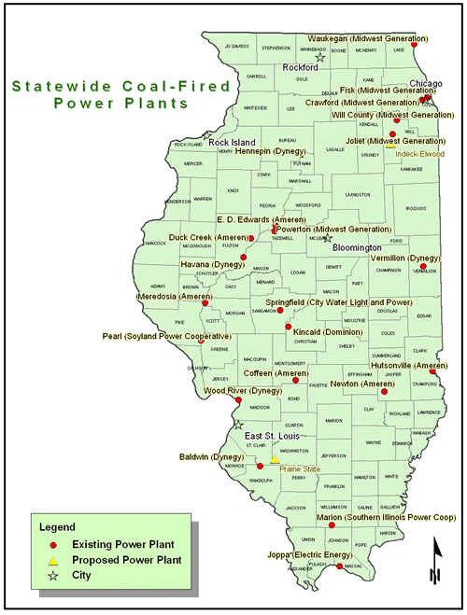

Slide 17
FOSSIL FUELS
Coal
World coal deposits are vast, ten times greater than conventional oil and gas resources combined.
Total resource is estimated at 10 trillion metric tons.
Proven-in-place reserves should last about 200 years.

Slide 18
FOSSIL FUELS
Coal
World coal deposits are vast, ten times greater than conventional oil and gas resources combined.
Total resource is estimated at 10 trillion metric tons.
Proven-in-place reserves should last about 200 years.

Slide 19
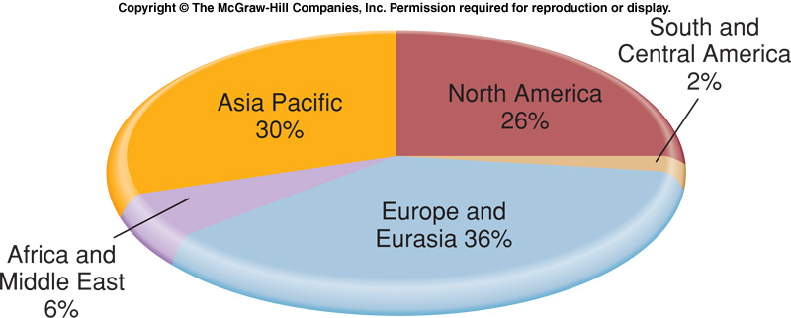
Proven Coal Reserves

Slide 20
Coal
Mining
About 40% of coal is located near the surface and can strip mined.
The other 60% is too deep underground.
Underground mining is dirty and dangerous; thousands of workers have died of respiratory diseases.
Black Lung Disease - Inflammation and fibrosis caused by accumulation of coal dust in the lungs or airways.

Slide 21
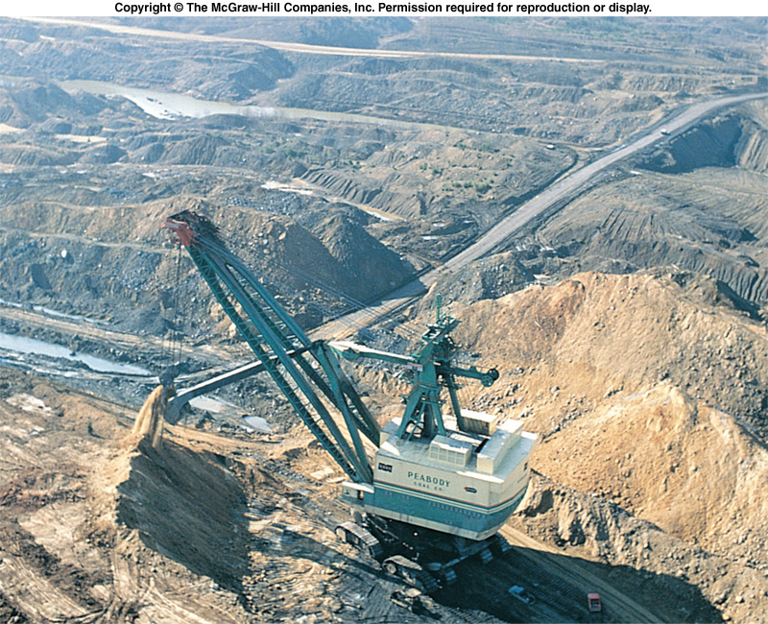
Figure 12.06

Slide 22
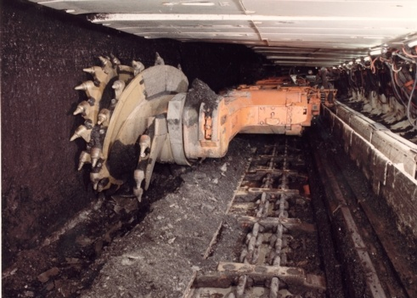

Slide 23
Coal Cont’d
Air Pollution
900 million tons of coal burned in U.S. for electric power generation.
Multiple pollutants released.
Sulfur Dioxide – Rotten eggs smell, creates acid rain (sulfuric acid)
Nitrogen Oxides – Brown haze, creates acid rain (nitric acid)
Particulates - Smoke
Carbon Dioxide – Greenhouse gas

Slide 24
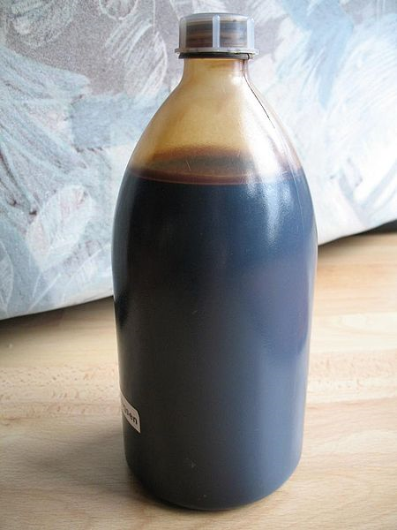
Oil
Petroleum
Liquid made mainly of carbon, but also hydrogen, nitrogen, oxygen, sulfur, and trace amounts of heavy metals.

Slide 25
Oil
Uses
Petroleum is most commonly distilled (separated) into fuels such as gasoline, kerosene, and diesel fuel.
Can also be used to create wax, plastics, tar, and asphalt.

Slide 26
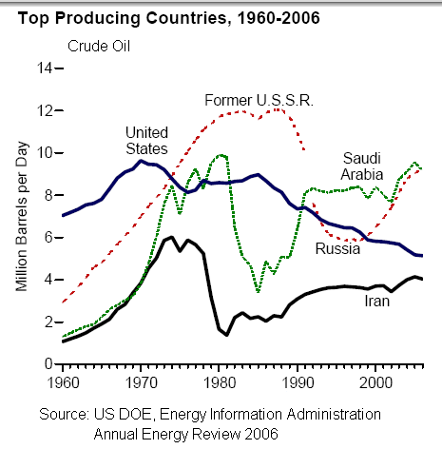
Oil
Resources and Reserves
In 2004, proven reserves were roughly 1 trillion barrels.
Estimated 800 billion barrels remain to be discovered.

Slide 27
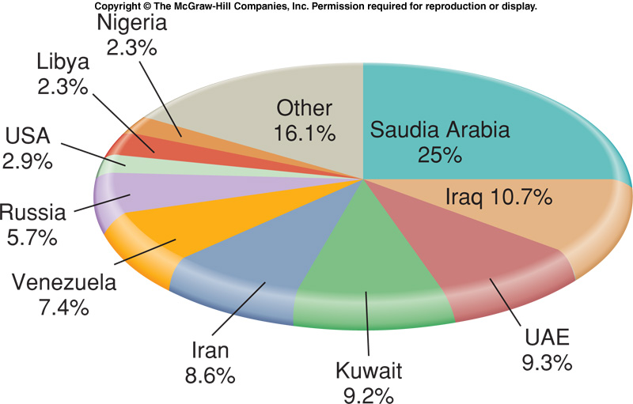
Proven Recoverable Oil Reserves

Slide 28
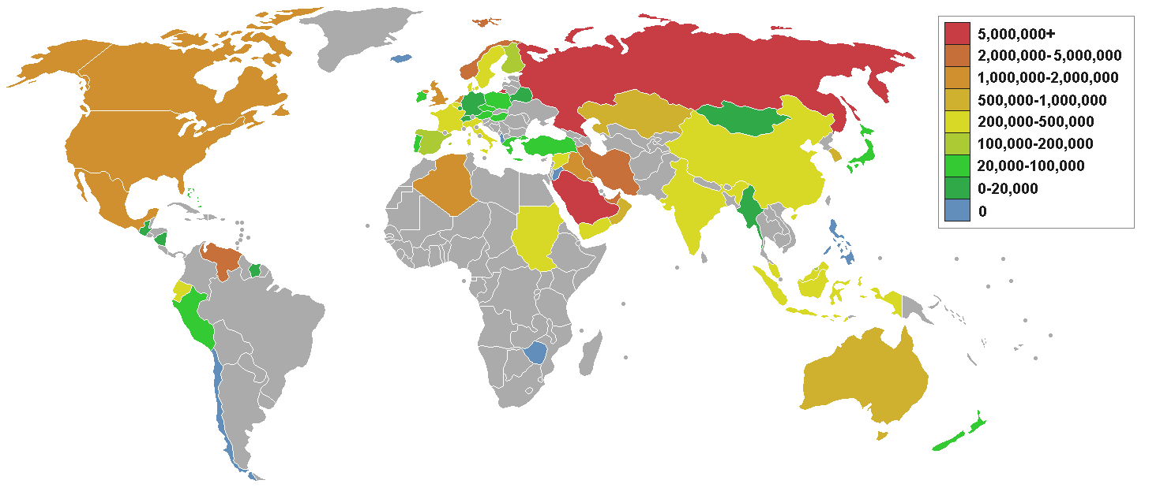
Worldwide Oil Exports

Slide 29
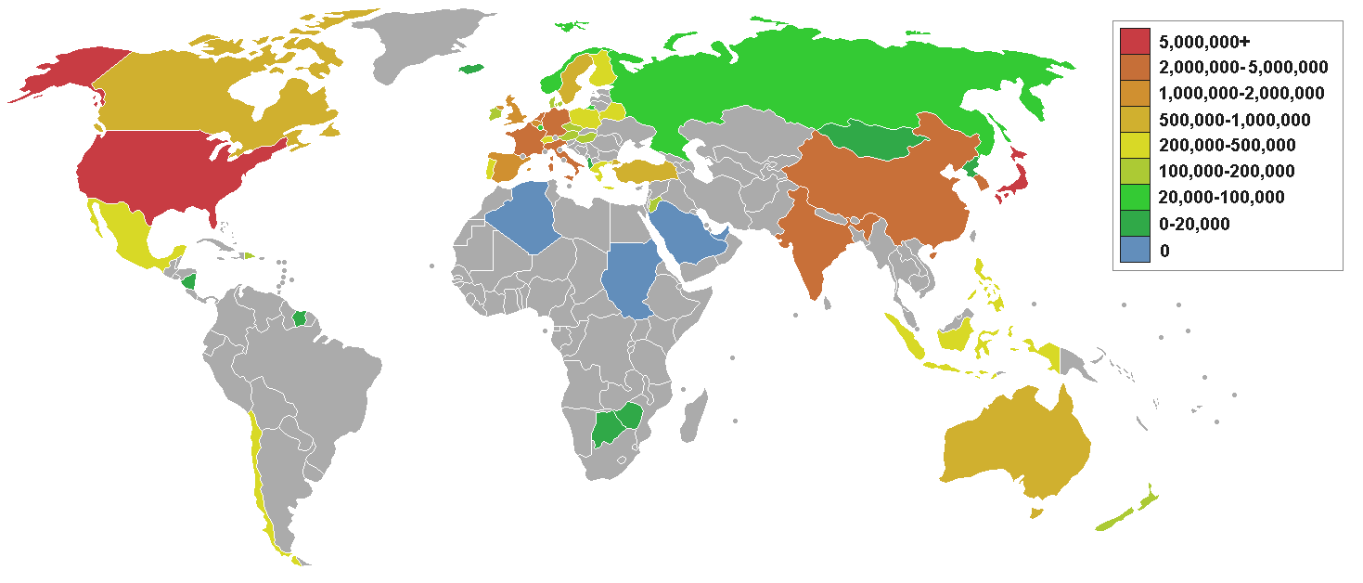
Worldwide Oil Imports

Slide 30
Oil Cont’d
The primary use of oil is for transportation.
Provides more than 90% of transportation energy.
There are no 100% oil-fired power plants in Illinois.

Slide 31
Natural Gas
World’s third largest commercial fuel.
23% of global energy consumption.
Produces half as much CO₂ as equivalent amount of coal.
Most rapidly growing energy source.
Difficult to ship long distances, and to store in large quantities.
Often extracted from the same wells as petroleum

Slide 32
Natural Gas Cont’d
Resources and Reserves
Proven world reserves of natural gas are 5,500 trillion cubic feet.
Current reserves represent roughly 60 year supply at present usage rates.

Slide 33
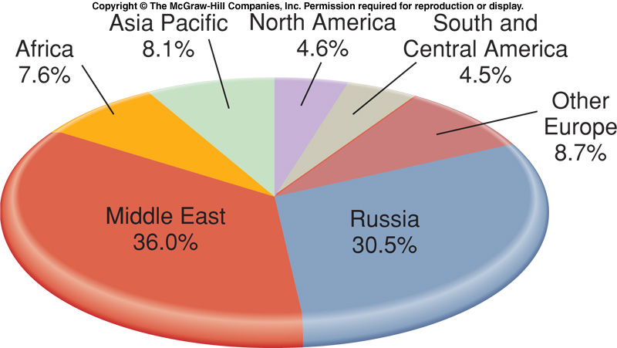
Proven-In-Place Natural Gas Reserves

Slide 34
Nuclear Power

Slide 35
NUCLEAR POWER
Nuclear technology was developed first as a weapon.
Two atomic bombs were dropped during World War II – Hiroshima and Nagasaki, Japan.
Yields of 15-21 kilotons of TNT.
Additional nuclear tests conducted after World War II were done so at the Bikini Atoll, one of the Marshall Islands in the Pacific Ocean.
This was known as “Operation Crossroads”
Total of 23 nuclear devices were detonated.
The most infamous detonation was code-named “Castle Bravo”.

Slide 36
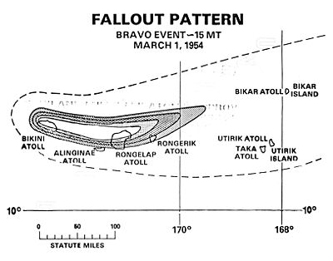
NUCLEAR POWER
Castle Bravo was the first test of a hydrogen bomb. This was the largest nuclear explosion ever set off by the United States, and was much more powerful than expected.
Widespread radioactive contamination was released by this explosion.
Among the contaminated was a 23-man Japanese fishing boat.
The scandal surrounding this test inspired the 1954 movie Godzilla.

Slide 37
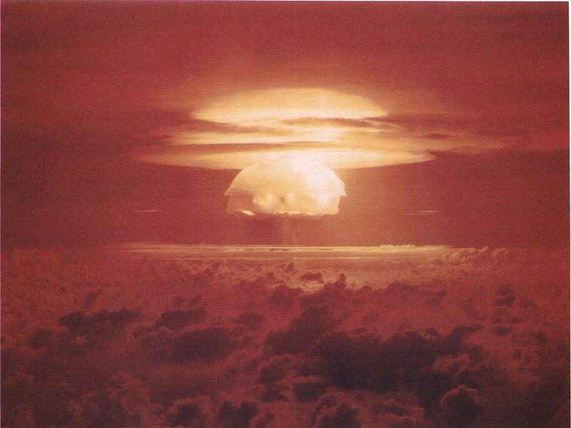
NUCLEAR POWER
Following the Castle Bravo detonation, the Partial Test Ban Treaty of 1963 was signed.
This banned all nuclear tests in the atmosphere, underwater, and in space.
Underground testing was still allowed.
The only nuclear powers that did not sign the treaty were China and France.

Slide 38
NUCLEAR POWER
President Dwight Eisenhower in 1953, gave a famous speech to the United Nations entitled “Atoms for Peace”.
“I feel impelled to speak today in a language that in a sense is new—one which I, who have spent so much of my life in the military profession, would have preferred never to use.
That new language is the language of atomic warfare.”
The purpose of this speech was to convey that Hiroshima and Nagasaki would not be repeated and that nuclear technology would be used for more peaceful purposes.

Slide 39
NUCLEAR POWER
“Our children will enjoy in their homes electrical energy too cheap to meter...”
-Lewis Strauss
Chairman, U.S. Atomic Energy Commission,
Between 1970-1974, American utilities ordered 140 new reactors.
100 subsequently canceled.
Electricity from nuclear power plants was about half the price of coal in 1970, but was twice as much in 1990.

Slide 40
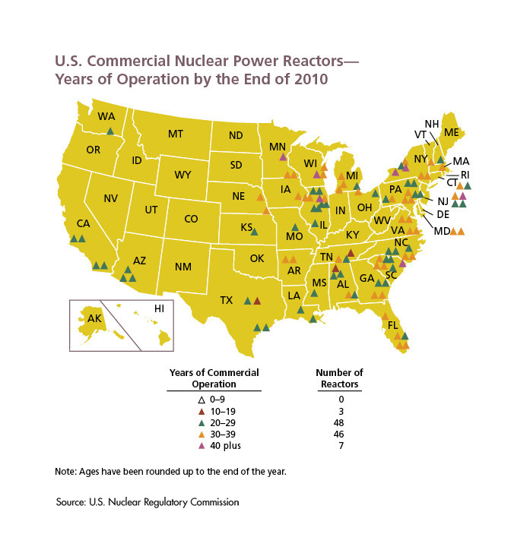

Slide 41
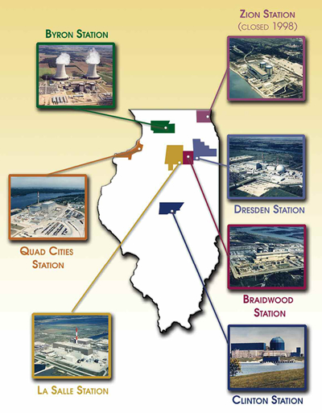

Slide 42
How is Nuclear Radiation Measured?
Radiation dose is measured in a unit called the sievert.
Radiation has both acute and chronic effects.
An immediate dose of 1Sv will cause radiation sickness. More than that can result in death.
Long-term doses can lead to chronic effects such as cancer, sterility, birth detects, etc.

Slide 43
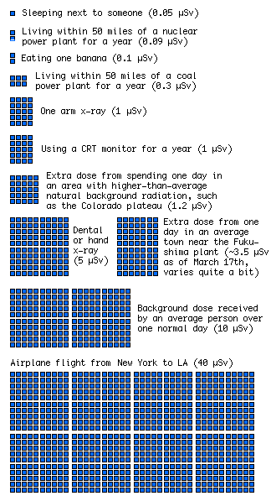
How is Nuclear Radiation Measured?

Slide 44
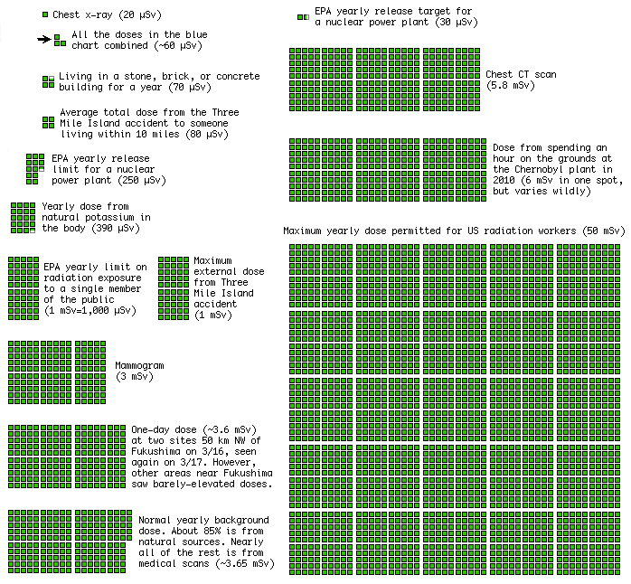
How is Nuclear Radiation Measured?

Slide 45
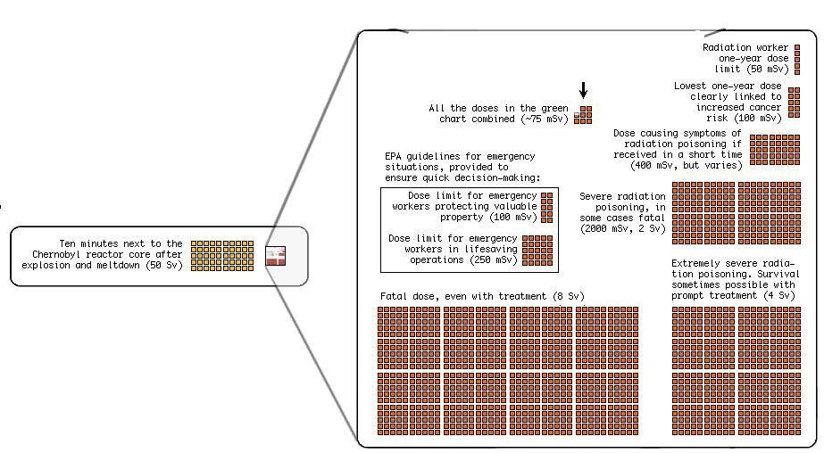
How is Nuclear Radiation Measured?

Slide 46
How Do Nuclear Reactors Work
Most commonly used fuel is U^{235,} a naturally occurring radioactive isotope of uranium.
Occurs naturally at 0.7% of uranium, but must be enriched to about of 3% to create a fuel pellet.

Slide 47
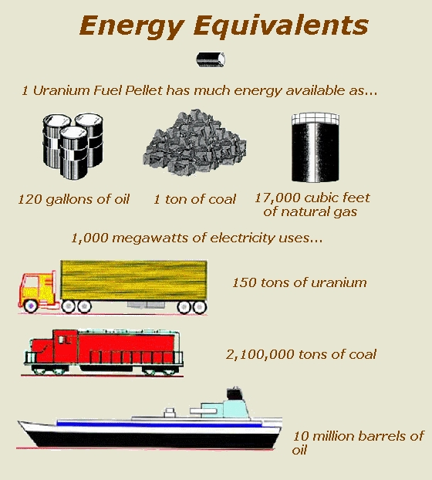
Uranium-235

Slide 48
How Do Nuclear Reactors Work Cont’d
Fuel pellets are cylinder-shaped (1.5cm long) stacked in hollow metal rods (4m long).
About 100 rods and bundled together to make a fuel assembly.
Thousands of fuel assemblies bundled in reactor core

Slide 49
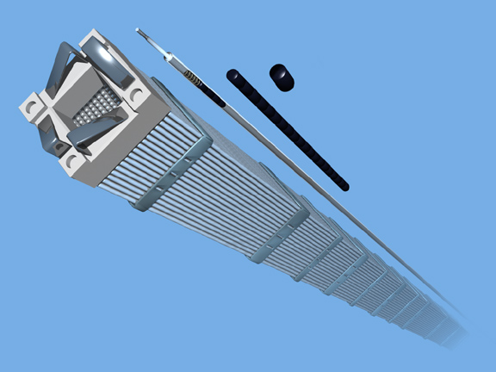
Fuel Rods Filled With Pellets Are Grouped Into Fuel Assemblies
Notes:
The pellets are inserted into long metal tubes called fuel rods. The fuel rods are made of zirconium—which resists heat, radiation and corrosion. The rods are bundled together into fuel assemblies, which are placed in the reactor.

Slide 50
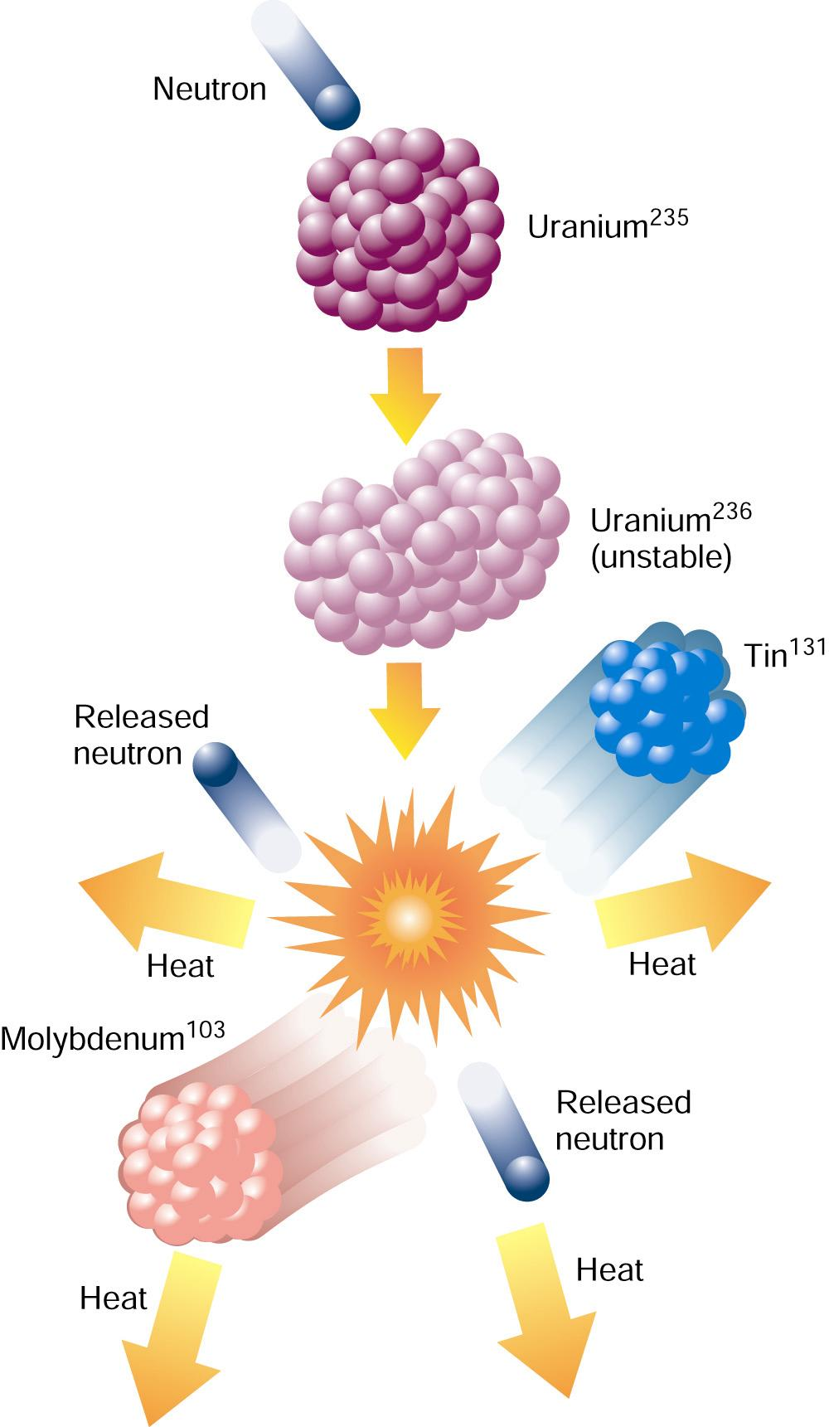
Nuclear Fission
When struck by neutrons, radioactive uranium atoms undergo nuclear fission, releasing energy and more neutrons.
Triggers nuclear chain reaction.

Slide 51
How Do Nuclear Reactors Work Cont’d
Reaction is moderated in a power plant by neutron-absorbing solution (Moderator).
In addition, Control Rods composed of neutron-absorbing material are inserted into spaces between fuel assemblies to control reaction rate.
Water or other coolant is circulated between the fuel rods to remove excess heat.

Slide 52
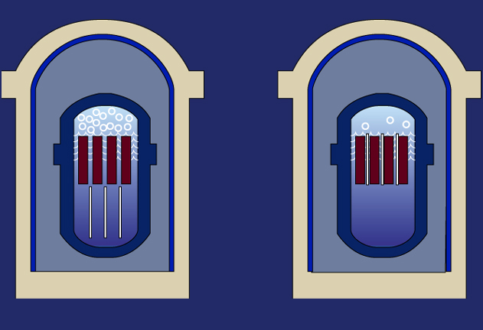
Controlling the Chain Reaction
Fuel
Assemblies
Control rods
Withdraw control rods,
reaction increases
Insert control rods,
reaction decreases
Notes:
Plant operators can control the chain reaction. Long rods are inserted among the fuel assemblies. These "control rods" are made to absorb neutrons, so the neutrons can no longer hit atoms and make them split. To speed up the chain reaction, plant operators withdraw the control rods, either partially or fully. To slow it, they insert the control rods.

Slide 53
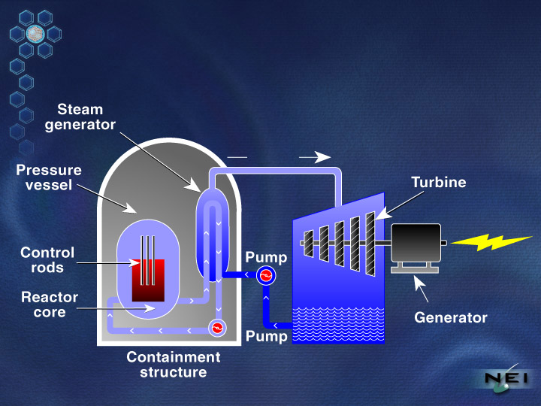
Kinds of Reactors
Seventy percent of nuclear power plants are pressurized water reactors.
Water circulated through core to absorb heat from fuel rods.
Pumped to steam generator where it heats a secondary loop.
Steam from secondary loop drives high-speed turbine producing electricity.

Slide 54
Kinds of Reactors Cont’d
Both reactor vessel and steam generator are housed in a special containment building preventing radiation from escaping, and providing extra security in case of accidents.
Under normal operating conditions, a PWR releases very little radioactivity.

Slide 55
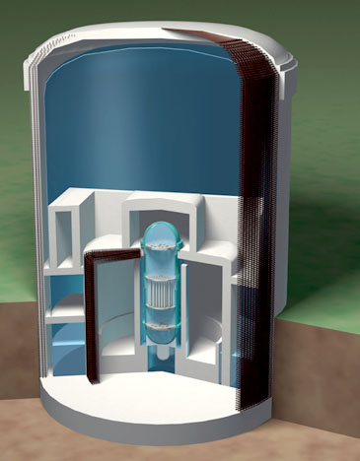
Safety Is Engineered Into Reactor Designs
Containment Vessel
1.5-inch thick steel
Shield Building Wall
3 foot thick reinforced concrete
Dry Well Wall
5 foot thick reinforced concrete
Bio Shield
4 foot thick leaded concrete with
1.5-inch thick steel lining inside and out
Reactor Vessel
4 to 8 inches thick steel
Reactor Fuel
Weir Wall
1.5 foot thick concrete
Notes:
Nuclear power plants use a series of physical barriers to make sure radioactive material cannot escape. In today’s water-cooled reactors, the first barrier is the fuel itself: the solid ceramic uranium pellets. Most of the radioactive by-products of the fission process remain inside the pellets. The pellets are sealed in zirconium rods, 12 feet long and half an inch in diameter. The fuel rods are placed inside a large steel reactor vessel, with walls 8 inches thick. The vessel is surrounded by 3 feet of concrete shielding. At most plants, a leak-tight steel liner covers the inside walls of the containment building. The containment building is a massive, reinforced concrete structure with walls 4 feet thick.

Slide 56
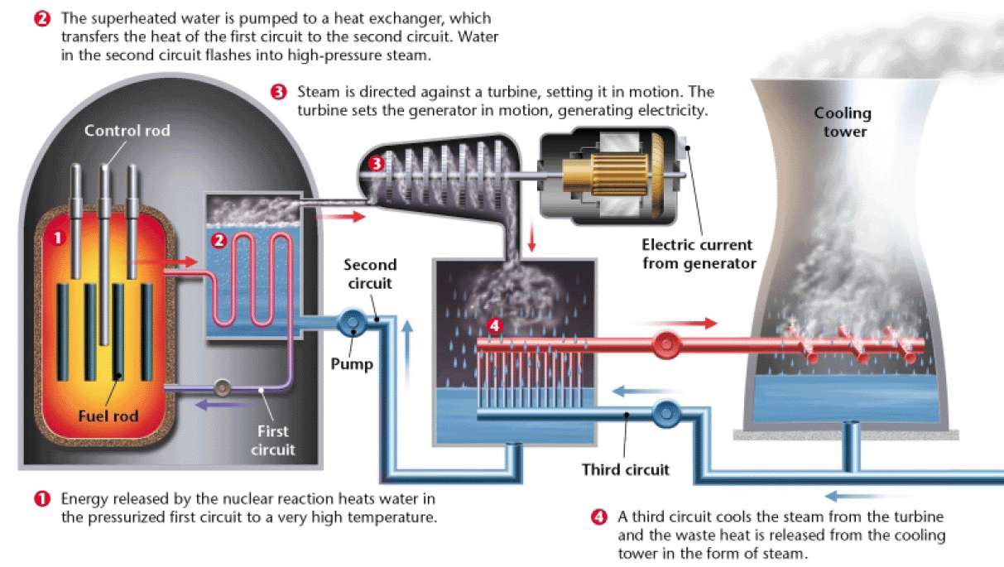
How Nuclear Energy Works

Slide 57
Nuclear Disasters
1979: Three Mile Island (near Harrisburg, PA)
Series of failures in nuclear core
Relief water valve stuck open
High amount of coolant allowed to escape.
Partial meltdown occurred
High amounts of radioactive xenon escaped, mostly went into atmosphere.
Two weeks earlier: The China Syndrome movie released
These events caused a ripple effect throughout the U.S.
Increased safety requirements and regulations for all nuclear reactors.
Public opinion turned against nuclear power.
Nearly complete end of nuclear construction since.

Slide 58
Nuclear Disasters
1986: Explosion at Chernobyl Nuclear Plant in Ukraine, U.S.S.R.
A controlled test of the safety emergency core cooling feature of the reactor was scheduled.
Concern over what would happen if a power failure occurred – backup generators took ~1 minute to reach full capacity.
Control rods had been nearly completely removed to put the reactor at full operating power.
When the test was started, the chain reaction began occurring uncontrollably.
When this was detected, a shutdown of the reactor was ordered.
An unknown design flaw in the tips of the control rods caused coolant fluid to be displaced.
This created an even larger energy spike, overwhelming the reactor containment, causing an explosion and a complete core meltdown.

Slide 59
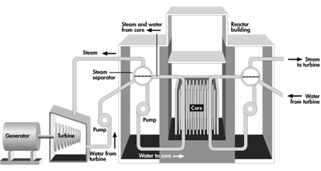
Chernobyl
The design of the Chernobyl plant also did not have an adequate containment building.
When the initial explosion occurred, the roof of the building was completely torn off, leaving the core exposed to the air and wind.

Slide 60
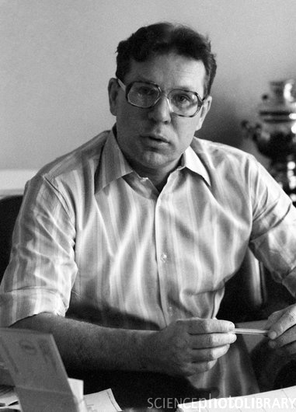
Chernobyl
Valery Legasov was in charge of finding out exactly what went wrong and how to deal with the disaster.
He discovered many unreported flaws in the reactor design, but was pressured not to reveal them.
The workers received most of the blame.
He committed suicide on the 2-year anniversary of the disaster.

Slide 61
Aftermath
A wide radius surrounding the reactor is now considered uninhabitable.
Surrounding towns and villages have shown a marked increase in birth defects, and multiple types of cancer, especially thyroid cancer.
Most common type of birth defect: Cardiac degeneration, known as “Chernobyl Heart”

Slide 62
Radioactive Waste Management
About 100,000 tons of low-level waste (clothing) and about 15,000 tons of high-level (spent-fuel) waste is stored in the U.S.
For past 20 years, spent fuel assemblies have been stored in deep water-filled pools at the power plants. (Designed to be temporary)
Many internal pools are now filled and a number plants are storing nuclear waste in metal dry casks outside.

Slide 63
Radioactive Waste Management Cont’d
U.S. Department of Energy announced plans to build a high-level waste repository near Yucca Mountain, Nevada in 1987.
Facility may cost between $10 and 35 billion; planned to be open in 2010.
Plans to use Yucca have since been halted due to politics and lawsuits.

