Slide 1
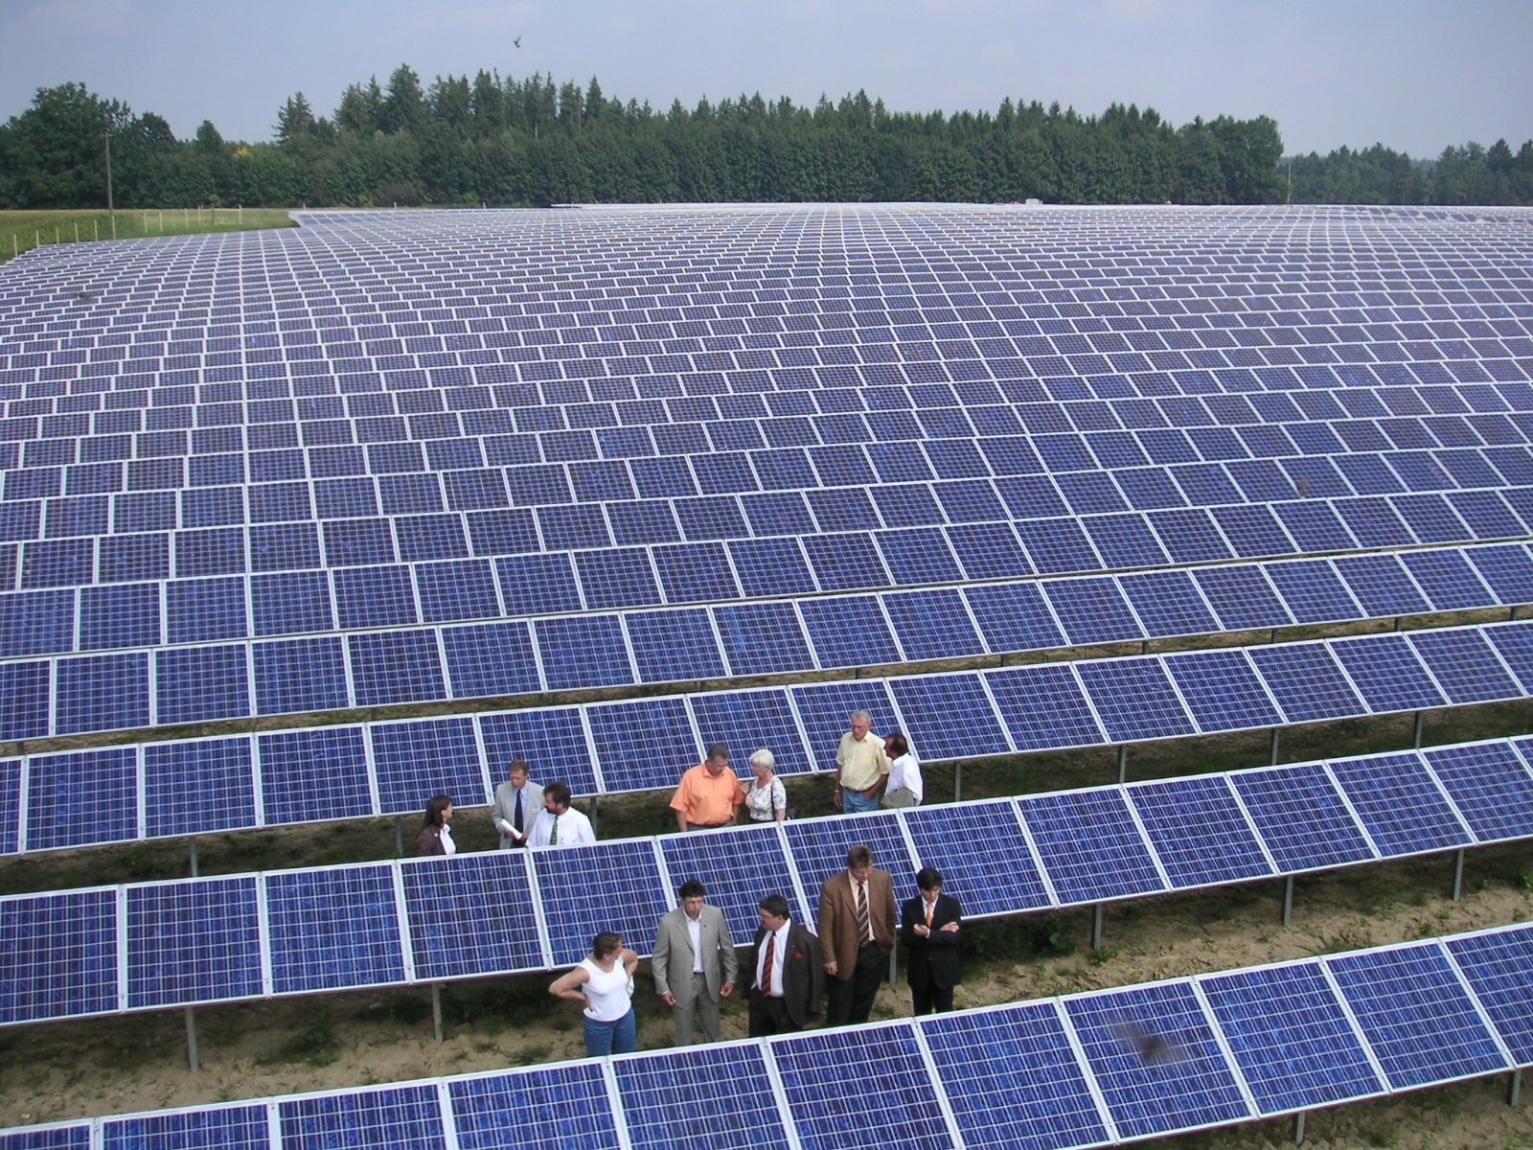
Renewable Energy
“The use of solar energy has not been opened up because the oil industry does not own the sun.”
- Ralph Nader

Slide 2
How Is Electricity Generated?
An electric generator is a device that converts mechanical energy into electrical energy through a turbine.
A turbine is a wheel that changes the force of a moving gas or a liquid into energy that can do work.
The turbine spins a generator to produce electricity.

Slide 3
SOLAR ENERGY
Average amount of solar energy arriving on top of the atmosphere is 1,330 watts per square meter.
Amount reaching the earth’s surface is 10,000 times more than all commercial energy used annually.
Until recently, this energy source has been too diffuse and low intensity to capitalize for electricity.

Slide 4
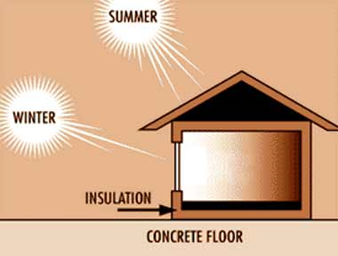
SOLAR ENERGY CONT’D
Passive Solar Heat - Using absorptive structures with no moving parts to gather and hold heat.
Image source: Top-Alternative-Energy-Sources.com

Slide 5
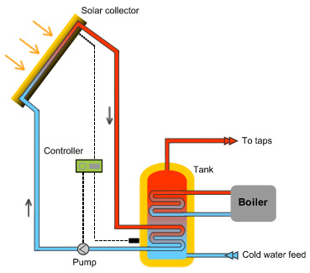
SOLAR ENERGY CONT’D
Active Solar Heat - Generally pump heat- absorbing medium through a collector, rather than passively collecting heat in a stationary object.
Water heating consumes 15% of U.S. domestic energy budget.
Image source: www.almeriaspas.com

Slide 6
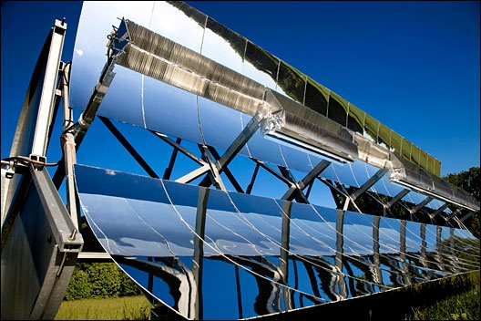
High-Temperature Solar Energy
Parabolic mirrors are curved reflective surfaces that collect light and focus it onto a concentrated point. Two techniques:
Long curved mirrors focused on a central tube containing a heat-absorbing fluid.

Slide 7
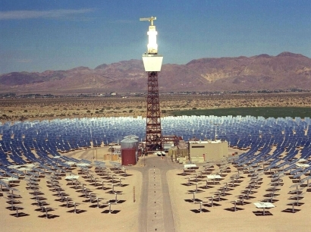
High-Temperature Solar Energy
Small mirrors arranged in concentric rings around a tall central tower track the sun and focus light on a heat absorber on top of the tower.

Slide 8
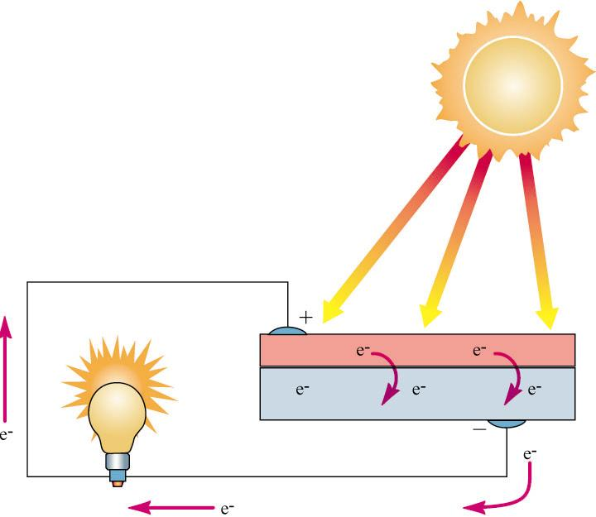
Photovoltaic Solar Energy
Photovoltaic cells capture solar energy and convert it directly to electrical current by separating electrons from parent atoms and accelerating them across a one-way electrostatic barrier.

Slide 9
Photovoltaic Cells
During the past 25 years, efficiency of energy capture by photovoltaic cells has increased from less than 1% of incident light to more than 10% in field conditions.
First developed at Bell Laboratories,1954
1958 - $2,000 / watt
1970 - $100 / watt
2002 - $5 / watt
2009 - $1 / watt

Slide 10
Storing Electrical Energy
Electrical energy storage is difficult and expensive.
Lead-Acid batteries
Heavy and have low energy density.
Typical lead-acid battery sufficient to store electricity for an average home would cost $5,000 and weigh 3-4 tons.
Nickel-Metal Hydride batteries
Higher capacity than lead, high discharge rate
Used in hybrid cars
Lithium-Ion batteries
Smaller, lighter, and more versatile
Expensive

Slide 11
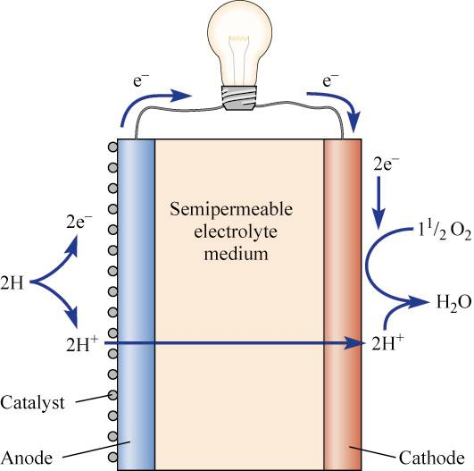
FUEL CELLS
Fuel Cells - Use the chemical reaction between hydrogen and oxygen to produce electric current.
H2 + O2 → H2O
High-energy electrons generated from the reaction pass through an external circuit, and generate electrical current.

Slide 12
FUEL CELLS CONT’D
Fuel cells provide direct-current electricity as long as supplied with hydrogen and oxygen.
Pure hydrogen must be supplied somehow.
Fuel cells run on pure oxygen and hydrogen produce no waste products except drinkable water and radiant heat.

Slide 13
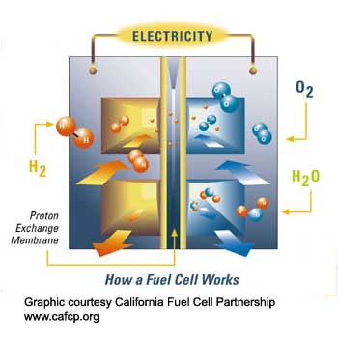
FUEL CELLS CONT’D
Typical fuel cell efficiency is 40-45%.
Fuel cells can be stacked together until the desired power level is achieved.

Slide 14
BIOMASS
Wood provides less than 1% of U.S. energy, but provides up to 95% in poorer countries.
Inefficient burning of wood produces smoke laden with fine ash and soot and hazardous amounts of carbon monoxide (CO) and hydrocarbons.
Produces fewer sulfur gases than coal.

Slide 15
Fuelwood Crisis
About 40% of world population depends on firewood and charcoal as their primary energy source.
Of these, three-quarters do not have an adequate supply.
Problem intensifies as less-developed countries continue to grow.
For urban dwellers, the opportunity to scavenge wood is generally nonexistent.

Slide 16
Fuelwood Crisis Cont’d
Currently, about half of worldwide annual wood harvest is used as fuel.
85% of fuelwood harvested and consumed in developed countries.
By 2025, worldwide demand for fuelwood is expected to be twice current harvest rates while supplies will have remained relatively static.

Slide 17
Dung
Where other fuel is in short supply, people often dry and burn animal dung.
Downside: not returning animal dung to land as fertilizer reduces crop production and food supplies.

Slide 18
Methane
Methane is main component of natural gas.
Produced by anaerobic (no oxygen) decomposition by bacteria.
Very efficient fuel source:
Burning methane produced from manure provides more heat than burning dung itself.
Left-over sludge from bacterial digestion is a nutrient-rich fertilizer.
Methane is clean, efficient fuel.

Slide 19
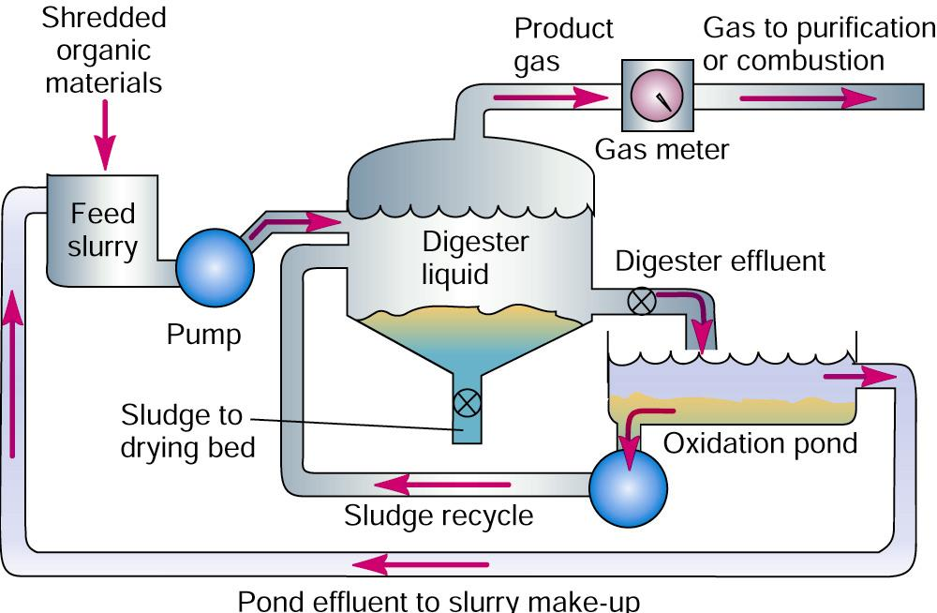
Anaerobic Fermentation

Slide 20
Alcohol from Biomass
Ethanol raises octane ratings, and helps reduce carbon monoxide emissions in automobile exhaust.
Could be solution to grain surpluses and bring higher price for grain crops.

Slide 21
ENERGY FROM EARTH’S FORCES
Hydropower
By 1925, falling water generated 40% of world’s electric power.
Hydroelectric production capacity has grown 15-fold.
Fossil fuel use has risen so rapidly that currently, hydroelectric only supplies one-quarter of electrical generation.

Slide 22
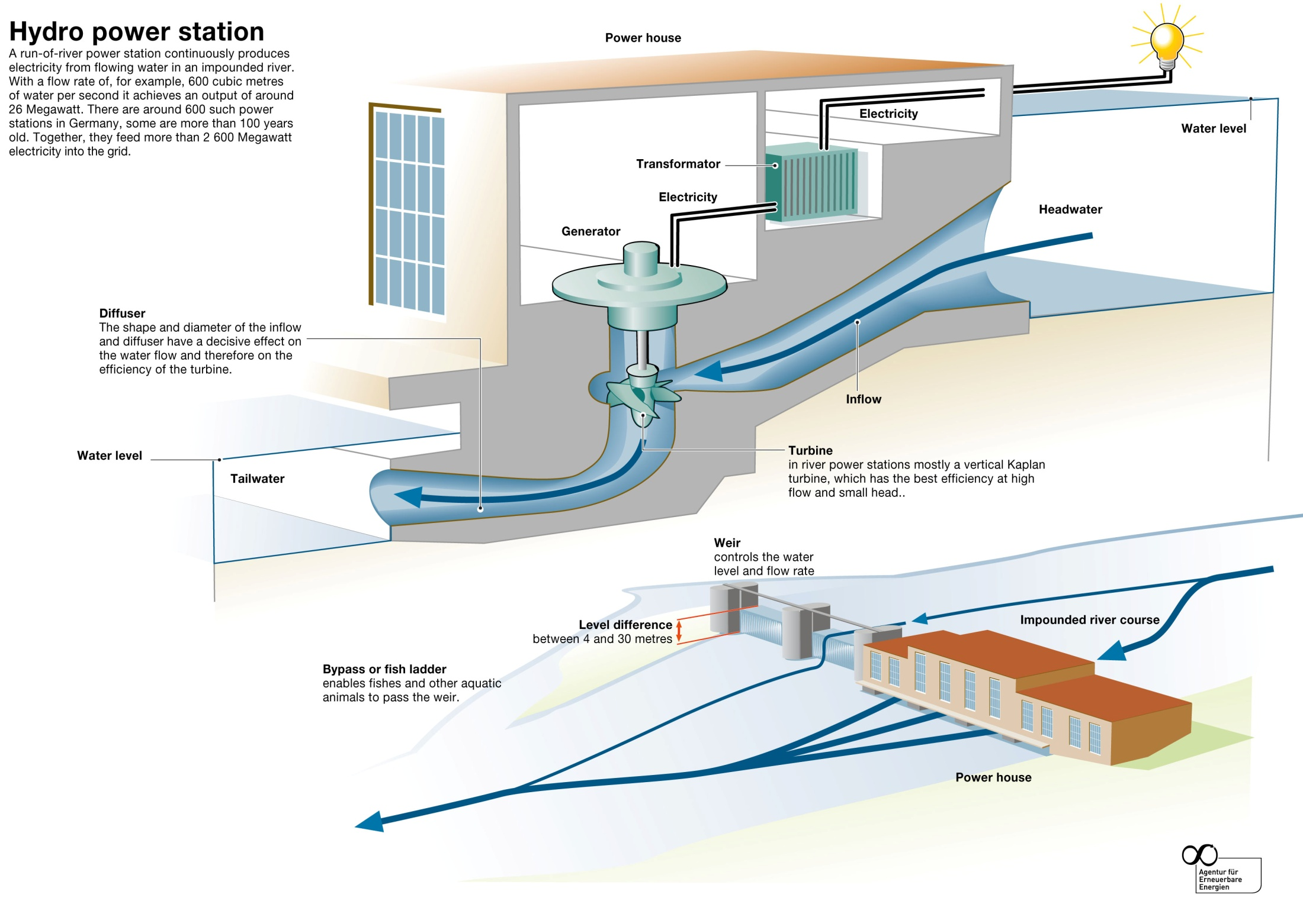

Slide 23
Dam Drawbacks
Human Displacement
Ecosystem Destruction
Wildlife Losses
Large-Scale Flooding Due to Dam Failures
Sedimentation
Herbicide Contamination
Evaporative Losses
Nutrient Flow Retardation

Slide 24
Case Study: Three Gorges Dam, China
Largest electricity-generating plant in the entire world.
Total capacity of the plant = 22,500MW
34 total generators
Caused the flooding of multiple archeological sites and displaced 1.3 million people.

Slide 25
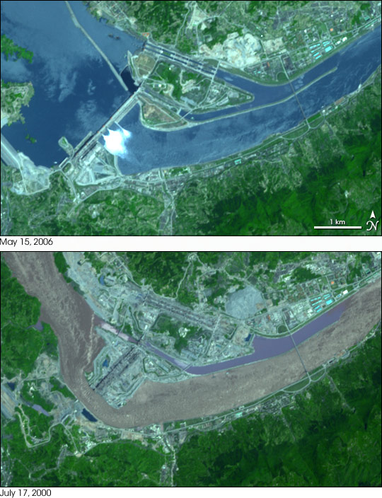
Three Gorges Dam

Slide 26
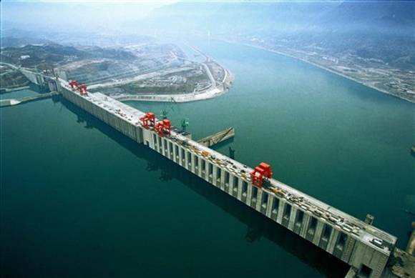
Three Gorges Dam

Slide 27
Wind Energy
Estimated 20 million MW of wind power could be commercially tapped worldwide.
Fifty times current nuclear generation.
Typically operate at 35% efficiency under field conditions.
Under normal conditions, (15 km/hr) electric prices typically run 5 cents per kilowatt hour.

Slide 28
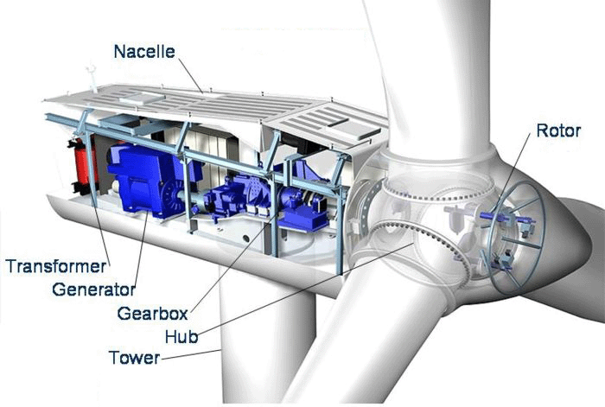

Slide 29
Wind Energy Cont’d
Wind Farms - Large concentrations of wind generators producing commercial electricity.
Negative Impacts:
Interrupt view in remote places
Destroy sense of isolation
Potential bird kills

Slide 30
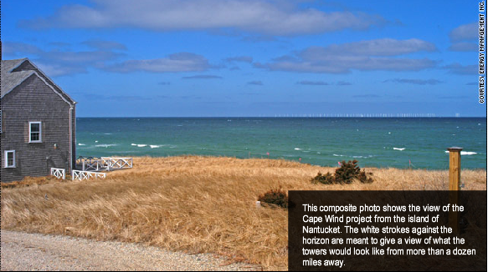

Slide 31
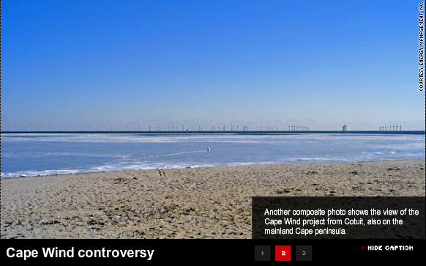

Slide 32
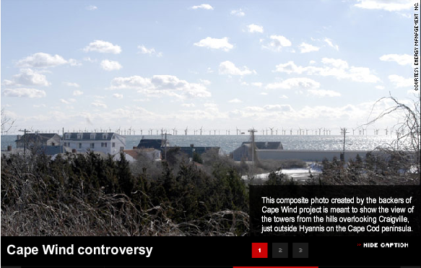

Slide 33
Geothermal Energy
High-pressure, high-temperature steam fields exist below the earth’s surface.
Recently, geothermal energy has been used in electric power production, industrial processing, space heating, agriculture, and aquaculture.
Have long life span, no mining needs, and little waste disposal.
Potential danger of noxious gases and noise problems from steam valves.

Slide 34
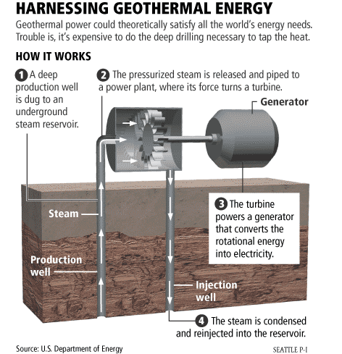

Slide 35
Tidal and Wave Energy
Ocean tides and waves contain enormous amounts of energy that can be harnessed.
Tidal Station - Tide flows through turbines, creating electricity.
Requires a high tide / low-tide differential of several meters.
Main worries are saltwater flooding behind the dam and heavy siltation.
Stormy coasts with strongest waves are often far from major population centers.

Slide 36
Energy Conversion Efficiencies
Energy Efficiency is a measure of energy produced compared to energy consumed.
Example: Light bulbs
Incandescent: 5-10% efficient
Compact fluorescent: 20-33% efficient
LED: 40-60% efficient

Slide 37
Promoting Renewable Energy
Distributional Surcharges
Small charge levied on all utility customers to help finance research and development.
Renewable Portfolio
Mandate minimum percentage of energy from renewable sources.
Green Pricing
Allow utilities to profit from conservation programs and charge premium prices for energy from renewable sources.

Slide 38
ENERGY CONSERVATION
Utilization Efficiencies
Most potential energy in fuel is lost as waste heat.
In response to 1970’s oil prices, average U.S. automobile gas-mileage increased from 13 mpg in 1975 to 28.8 mpg in 1988.
Falling fuel prices of the 1980’s discouraged further conservation.

