Slide 1
The Chemical Context of Life
KEY CONCEPTS:
1. Matter consists of chemical elements in pure form and in combinations called compounds.
2. An elements properties depend on the structure of its atoms
3. The formation and function of molecules depend on chemical bonding between atoms
4. Chemical reactions make and break chemical bonds.

Slide 2
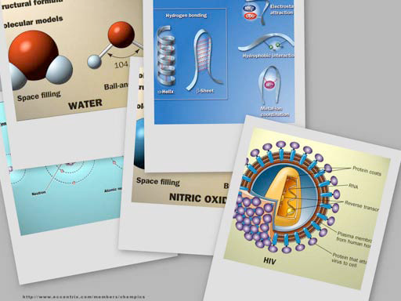
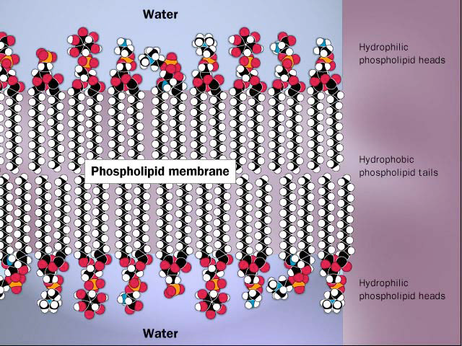
Why are we studying chemistry? Biology has chemistry at its foundation

Slide 3
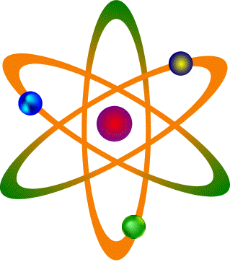
The Basics Everything is made of matter Matter is made of atoms Atoms are made of:
______________
___________________ in ____________________
PROTONS (+)
NEUTRONS (0)
ELECTRONS (-)
Different kinds of atoms = elements

Slide 4
About 25 elements are essential for life
Four elements make up 96% of living matter: Carbon (C), Oxygen (O), Hydrogen (H), and Nitrogen (N)
Four elements make up most of remaining 4%: Sulfur (S), Phosphorus (P), Potassium K),and Calcium (Ca)
Used to make bigger molecules
Ions = electrically charged atoms
____________
____________
____________
____________
____________
____________
Carbon - C
____________
____________
____________
____________
____________
Sodium – Na⁺
Oxygen - O
Chloride – Cl⁻
Hydrogen - H
Potassium – K⁺
Nitrogen - N
Calcium – Ca⁺⁺
Sulfur - S
Hydrogen – H⁺
Phosphorus - P

Slide 5
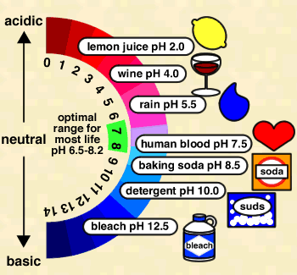
Hydrogen Ions (H⁺)
The number of H+ ions determines how acidic a solution will be.
More H⁺ = more acidic

Slide 6
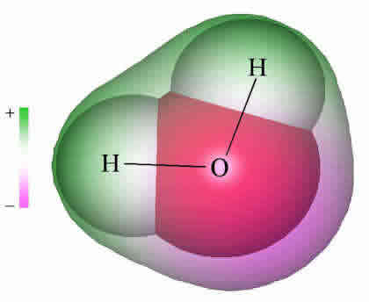
ATOMS CAN JOIN TOGETHER TO Make Molecules
Ex:
Joining 2 HYDROGEN atoms with 1 OXYGEN atom makes one WATER molecule.
A chemical formula tells what kind of and how many atoms are in a molecule
EX: ________
H₂O

Slide 7
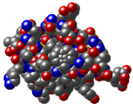
VERY, VERY LARGE
MOLECULES
= MACROMOLECULES
EXAMPLE:
Insulin =
C₂₅₄ H₃₇₇ N₆₅ O₇₆ S₆

Slide 8
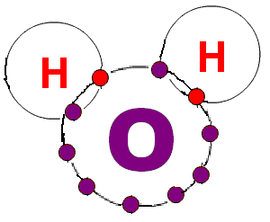
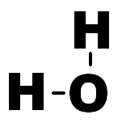
MOLECULES CAN BE SHOWN IN DIFFERENT WAYS
H₂O

Slide 9
CARBON is the most important atom found in living things
It can join to four
other atoms at same time
It can form rings or chain
so it can make lots of
different kinds of molecules.

Slide 10
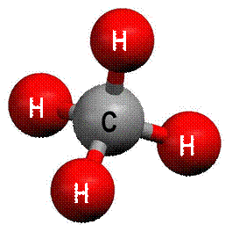
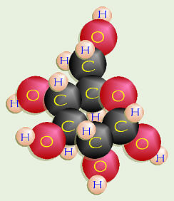
ORGANIC molecules are found in living things and contain CARBON atoms

Slide 11
A chemical equation tells what happens in a chemical reaction
when molecules interact.
NaOH + HCl → NaCl + H₂0
_______________ _______________
Molecules that react Molecules that are
produced
→
REACTANTS
PRODUCTS

Slide 12
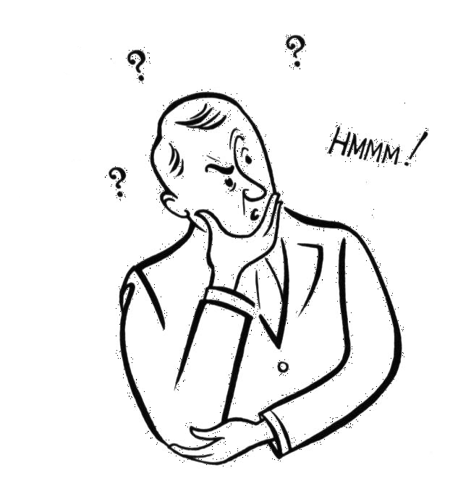
REMEMBER: ALL the chemical reactions that happen in cells = METABOLISM
Chemical reactions can join molecules together.
Chemical reactions can break molecules apart.

Slide 13
Living things use BOTH of these kinds of reactions (and MORE) to get the materials they need.

Slide 14
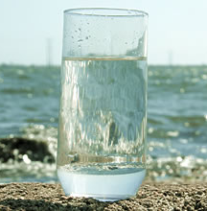
WATER is important for all living things
Average person ~~ 60-70% water
Babies ~~ 78%
Human brain ~~ 90%

Slide 15
WHY Water is important to cells:
1. It’s POLAR so it can DISSOLVE lots of different substances.
2. It can absorb lots of HEAT WITHOUT changing temperature very much. (That helps with homeostasis)
3. HYDROGEN BONDS form between water
molecules so they stick together.
4.Water is an important REACTANT/PRODUCT
in many CHEMICAL REACTIONS.

