Slide 1
Table of Contents
Water
Section 1 Water Resources
Section 2 Water Use and Management
Section 3 Water Pollution

Slide 2
Objectives
Section 1 Water Resources
Describe the distribution of Earth’s water resources.
Explain why fresh water is one of Earth’s limited resources.
Describe the distribution of Earth’s surface water.
Describe the relationship between groundwater and surface water in a watershed.

Slide 4
Water Resources
Section 1 Water Resources
Water is essential to life on Earth. Humans can live for more than month without food, but we can live for only a few days without water.
Two kinds of water found on Earth:
Fresh water, the water that people can drink, contains little salt.
Salt water, the water in oceans, contains a higher concentration of dissolved salts.
Most human uses for water, such as drinking and agriculture, require fresh water.

Slide 5
The Water Cycle
Section 1 Water Resources
Water is a renewable resource because it is circulated in the water cycle.
In the water cycle, water molecules travel between the Earth’s surface and the atmosphere. Water evaporates at the Earth’s surface. Water vapor rises into the air. As the vapor rises, it condenses to form clouds. Eventually the water in clouds falls back to the Earth.
The oceans are important because almost all of the Earth’s water is in the ocean.

Slide 6
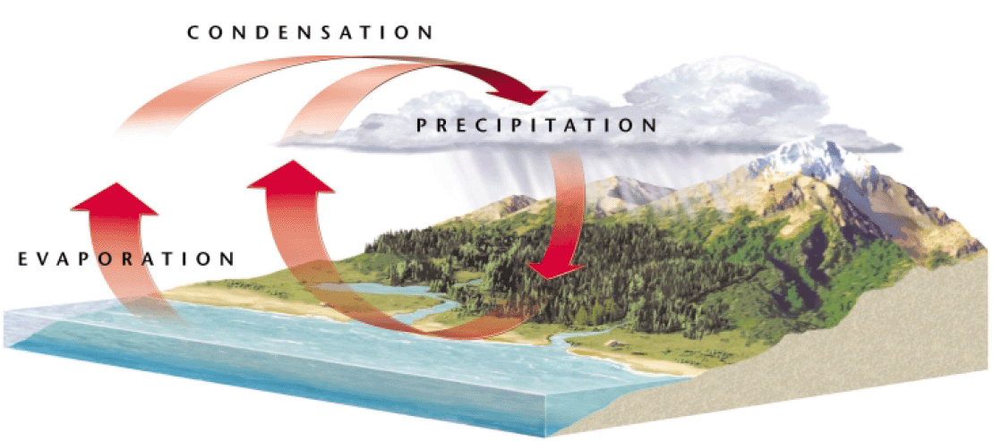
The Water Cycle
Section 1 Water Resources

Slide 7
Section 1 Water Resources
Although 71 percent of the Earth’s surface is covered with water, nearly 97 percent of Earth’s water is salt water in oceans and seas.
Of the fresh water on Earth, about 77 percent is frozen in glaciers and polar icecaps.
Only a small percentage of the water on Earth is liquid fresh water that humans can use.

Slide 8
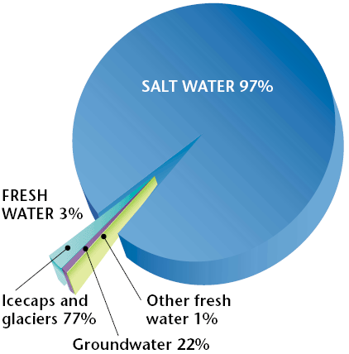
Global Water Distribution
Section 1 Water Resources
The fresh water we use comes mainly from lakes and rivers and from a relatively narrow zone beneath the Earth’s surface.

Slide 9
Surface Water
Section 1 Water Resources
Surface water is all the bodies of fresh water, salt water, ice, and snow, that are found above the ground.
The distribution of surface water has played a vital role in the development of human societies.
Throughout history, people have built cities and farms near reliable sources of water. Today, most large cities depend on surface water for drinking water, water to grow crops, food such as fish, power for industry, and transportation.

Slide 10
River Systems
Section 1 Water Resources
Streams form as water from falling rain and melting snow drains from mountains, hills, plateaus, and plains. As streams flow downhill, they combine with other streams and form rivers.
A river system is a flowing network of rivers and streams draining a river basin.
The Amazon River system is the largest river system in the world as it drains an area of land that is nearly the size of Europe.

Slide 11
Watersheds
Section 1 Water Resources
A watershed is the area of land that is drained by a water system.
The amount of water that enters a watershed varies throughout the year.
Rapidly melting snow as well spring and summer rains can dramatically increase the amount of water in a watershed. At other times of the year, the river system that drains a watershed may be reduced to a trickle.

Slide 12
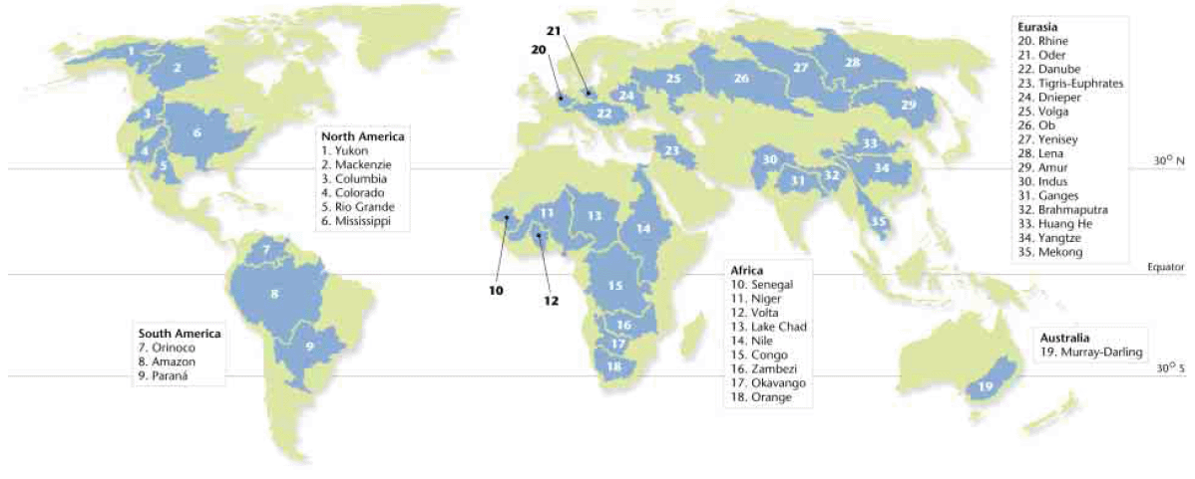
Watersheds
Section 1 Water Resources

Slide 13
Groundwater
Section 1 Water Resources
Most of the fresh water that is available for human use cannot be seen, as it exists underground.
But much of the water percolates through the soil and down into the rocks beneath.
Groundwater is the water that is beneath the Earth’s surface.

Slide 14
Aquifers
Section 1 Water Resources
An aquifer is a body or rock or sediment that stores groundwater and allows the flow of groundwater. They are an important water source for many cities.

Slide 15
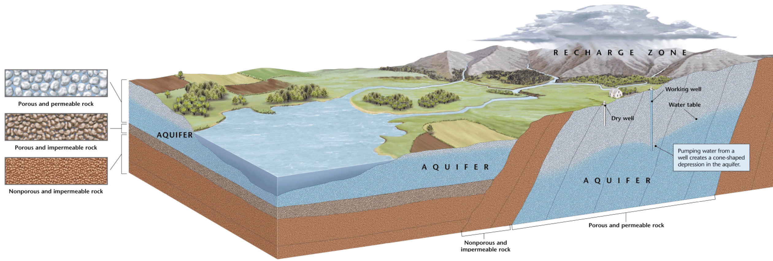
The Recharge Zone
Section 1 Water Resources

Slide 16
The Recharge Zone
Section 1 Water Resources
The size of an aquifer’s recharge zone is affected by the permeability of the surface above the aquifer.
Structures such as buildings and parking lots can act as impermeable layers and reduce the amount of water entering an aquifer.

Slide 17
The Recharge Zone
The Recharge Zone
The Recharge Zone
Communities should carefully manage recharge zones, because surface water can take a very long time to refill an aquifer, even tens of thousands of years

Slide 18
Wells
Section 1 Water Resources
A hole that is dug or drilled to reach groundwater is called a well.
Humans have dug wells to reach groundwater for thousands of years.
We dig wells because ground water may be a more reliable source of water than surface water and because water is filtered and purified as it travels underground.

Slide 19
Objectives
Section 2 Water Use and Management
Identify patterns of global water use.
Explain how water is treated so that it can be used for drinking.
Identify how water is used in homes, in industry, and in agriculture.
Describe how dams and water diversion projects are used to manage freshwater resources.
Identify five ways that water can be conserved.

Slide 20
Water Use and Management
Section 2 Water Use and Management
When a water supply is polluted or overused, everyone living downstream can be affected.
A shortage of clean, fresh water is one of the world’s most pressing environmental problems.
According to the World Health Organization, more than 1 billion people lack access to a clean, reliable source of fresh water.

Slide 21
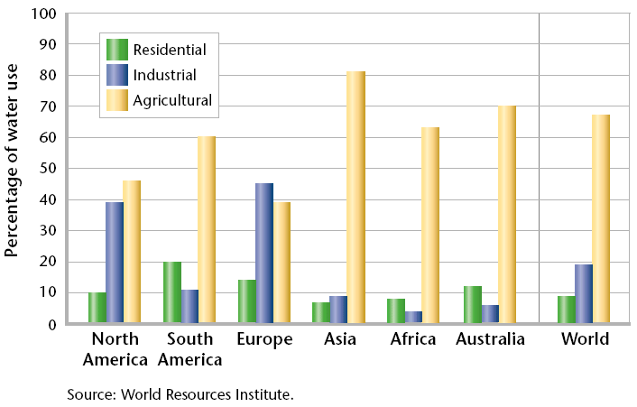
Global Water Use
Section 2 Water Use and Management
There are three major uses for water: residential use, agricultural use, and industrial use.

Slide 22
Global Water Use
Section 2 Water Use and Management
Most of the fresh water used worldwide is used to irrigate crops.
However, patterns of water use are not the same everywhere. The availability of fresh water, population sizes, and economic conditions affect how people use water.
Industry accounts for about 19 percent of the water used in the world, with the highest percent occurring in North America and Europe. About 8 percent of water is used by households.

Slide 23
Residential Water Use
Section 2 Water Use and Management
In the U.S., only about half of residential water use is for activities inside the home, such as drinking and cooking. The remainder of the water used residentially is used for activities outside the home such as watering lawns.

Slide 24
Residential Water Use
Section 2 Water Use and Management
There are striking differences in residential water use throughout the world. For example, the average person in the United States uses about 300 L of water a day. But in India, the average person uses only 41 L of water everyday.

Slide 25
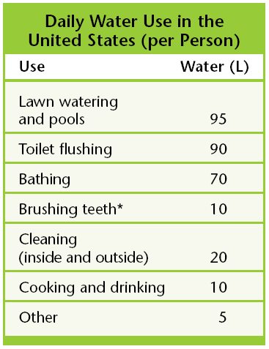
Section 2 Water Use and Management

