Slide 1
Water Treatment
Section 2 Water Use and Management
Most water must first be made potable.
Potable means suitable for drinking.
Water treatment removes elements such as mercury, arsenic, and lead, which are poisonous to humans even in low concentrations.
These elements are found in polluted water, but they can also occur naturally in groundwater.

Slide 2
Water Treatment
Section 2 Water Use and Management
A pathogen is a virus, microorganism, or other substance that causes disease.
Pathogens are found in water contaminated by sewage or animal feces, but can be removed with water treatment.
There are several methods of treating water to make it potable. A common method includes both physical and chemical treatment.

Slide 3
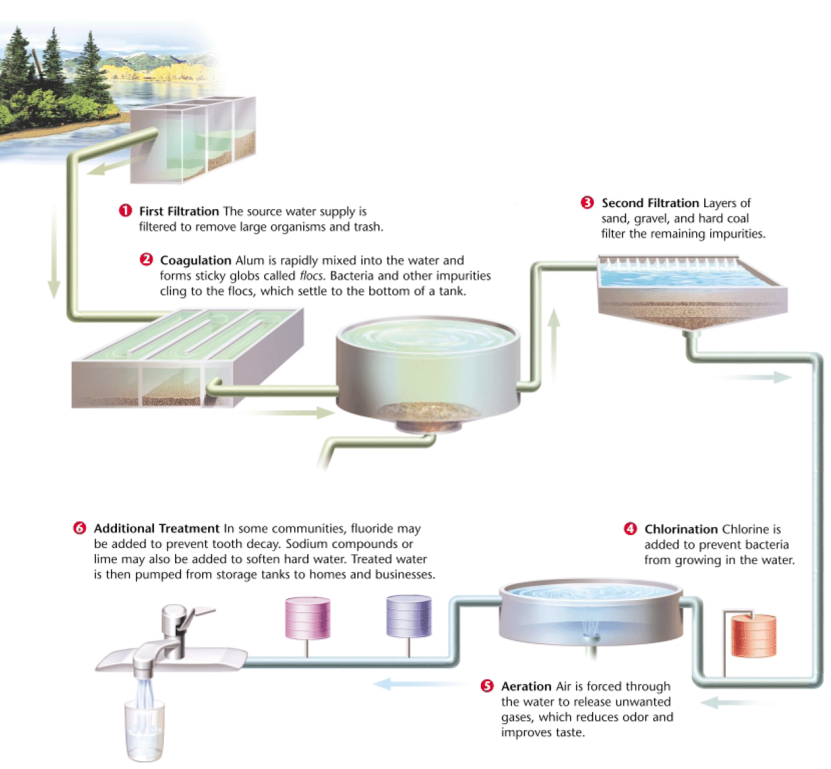
Drinking-Water Treatment
Section 2 Water Use and Management

Slide 4
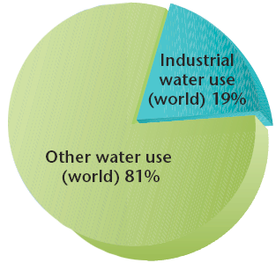
Industrial Water Use
Section 2 Water Use and Management
Industry accounts for 19 percent of water used in the world. Water is used to manufacture goods, to dispose of wastes, and to generate power.

Slide 5
Industrial Water Use
Section 2 Water Use and Management
Most of the water that is used in industry is used to cool power plants.
Power-plant cooling systems usually pump water from a surface water source such as a river or a lake, carry the water through pipes in a cooling tower, and then pump the water back into the source.
The water that is returned is usually warmer than the source, but is generally clean and can be used again.

Slide 6
Agricultural Water Use
Section 2 Water Use and Management
Agriculture accounts for 67 percent of the water used in the world. Plants require a lot of water to grow, and as much as 80 percent of the water used in agriculture evaporates.

Slide 7
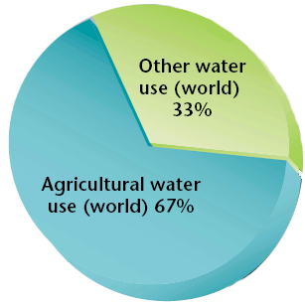
Agricultural Water Use
Section 2 Water Use and Management

Slide 8
Irrigation
Section 2 Water Use and Management
Irrigation is a method of providing plants with water from sources other than direct precipitation.
Many different irrigation techniques are used today. For example, some crops are irrigated by shallow, water filled ditches.
In the U.S., high-pressured overhead sprinklers are the most common form of irrigation. However, this method is inefficient because nearly half the water evaporates and never reaches the plant roots.

Slide 9
Water Management Projects
Section 2 Water Use and Management
People often prefer to live in areas where the natural distribution of surface water is inadequate.
Water management projects, such as dams, are designed to meet these needs.
Water management projects can have various goals, such as brining in water to make a dry area habitable, creating a reservoir for drinking water, or generating electric power, which then allows people to live and grow crops in desert areas.

Slide 10
Water Diversion Projects
Section 2 Water Use and Management
To supply dry regions with water, all or part of a river can be diverted into canals that carry water across great distances.
The Colorado River begins as a glacial stream in the Rocky Mountains and quickly grows larger as other streams feed into it. As the river flows south, it is divided to meet the needs of 7 states.
So much of the river’s water is diverted for irrigation and drinking water that the river runs dry before it reaches the Gulf of California.

Slide 11
Dams and Reservoirs
Section 2 Water Use and Management
A dam is a structure that is built across a river to control a river’s flow.
A reservoir is an artificial body of water that usually forms behind a dam. Water from a reservoir can be used for flood control, drinking water, irrigation, recreation, and industry.
Hydroelectric dams use the power of flowing water to turn a turbine that generates electrical energy. About 20 percent of the world electrical energy is generated using this method.

Slide 12
Dams and Reservoirs
Section 2 Water Use and Management
But, interrupting a river’s flow can have consequences. For example, when the land behind a dam is flooded, people are displaced, and entire ecosystems can be destroyed.
Fertile sediment also builds up behind a dam instead of enriching the land farther down the river, and farmland below may be less productive.
Dam failure can be another problem. If a dam bursts, the people living along the river below may be killed.

Slide 13
Water Conservation
Section 2 Water Use and Management
As water sources become depleted, water becomes more expensive.
This is because wells must be dug deeper, water must be piped greater distances, and polluted water must be cleaned up before it can be used.
Water Conservation is one way that we can help ensure that everyone will have enough water at a reasonable price.

Slide 14
Water Conservation in Agriculture
Section 2 Water Use and Management
Most of the water loss in agriculture comes from evaporation, seepage, and runoff, so technologies that reduce these problems go a long way toward conserving water.
Drip irrigation systems offer a promising step toward conservation. They deliver small amounts of water directly to plant roots by using perforated tubing. Water is released to plants as needed and at a controlled rate.

Slide 15
Water Conservation in Industry
Section 2 Water Use and Management
In industry today, the most widely used water conservation practices involve the recycling of cooling water and wastewater. Instead of discharging used water into a nearby river, businesses often recycle water and use it again.
In an innovative program, Denver, Colorado pays small businesses to introduce water conservation measures. This not only saves money for the city and the business but also makes more water available for agricultural and residential use.

Slide 16
Water Conservation at Home
Section 2 Water Use and Management
People can conserve water by changing a few everyday habits and by using only the water that they need. Water-saving technology, such as low-flow toilets, can also help reduce household water use.
To conserve water, many people water their lawns at night to reduce the amount of evaporation. Another way some people conserve water outside the home is by xeriscaping, or designing a landscape that requires minimal water use.

Slide 17
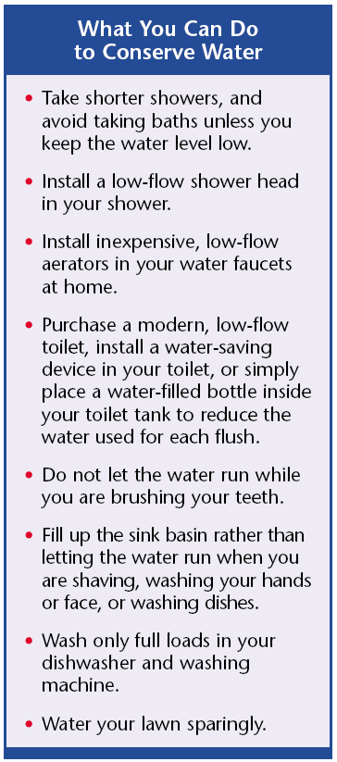
Water Conservation at Home
Section 2 Water Use and Management

Slide 18
Solutions for the Future
Section 2 Water Use and Management
Two possible solutions are:
Desalination
Transporting Fresh Water

Slide 19
Desalination
Chapter 11
Section 2 Water Use and Management
Desalination is the process of removing salt from ocean water.
Some countries in drier parts of the world, such as the Middle East, have built desalination plants to provide fresh water.

Slide 20
Most desalination plants heat salt water and collect the fresh water that evaporates.
Because desalination consumes a lot of energy, the process is too expensive for many nations to consider.

Slide 21
Transporting Water
Section 2 Water Use and Management
In some areas of the world where freshwater resources are not adequate, water can be transported from other regions.
For example, ships regularly travel from the mainland to the Greek islands towing enormous plastic bags full of fresh water. The ships anchor in port, and fresh water is then pumped onto the islands.

Slide 22
Transporting Water
Section 2 Water Use and Management
This bag solution is also being considered in the United States, where almost half of the available fresh water is in Alaska.
Because 76 percent of the Earth’s fresh water is frozen in icecaps, icebergs are another potential freshwater source.
For years, people have considered towing icebergs to communities that lack fresh water. But an efficient way to tow icebergs is yet to be discovered.

Slide 23
Water Pollution
Section 3 Water Pollution
Water pollution is the introduction into water of waste matter or chemicals that are harmful to organisms living in the water or to those that drink or are exposed to the water.
Almost all of the ways that we use water contribute to water pollution.
However, the two underlying causes of water pollution are industrialization and rapid human population growth.

Slide 24
Water Pollution
Section 3 Water Pollution
Developed countries have made great strides in cleaning up many polluted water supplies, but some water is still dangerously polluted.
In developing parts of the world, water pollution is a big problem because often the only water available for drinking in the these countries is polluted with sewage and agriculture runoff, which can spread waterborne diseases.
Water pollution comes from two types of sources: point and nonpoint sources.

Slide 25
Point-Source Pollution
Section 3 Water Pollution
When you think of water pollution, you probably think of a single source, such as a factory, a wastewater treatment plant, or a leaking oil tanker. These are all examples of point-source pollution.
Point-source pollution is pollution that comes from a specific site.
Although point-source pollution can often be identified and traced to a source, enforcing cleanup is sometimes difficult.

Slide 26
Nonpoint-Source Pollution
Section 3 Water Pollution
Non-point source pollution is pollution that comes from many sources rather than from a single specific site. An example is pollution that reaches a body of water from streets and storm sewers.
The accumulation of small mounts of water pollution from many sources is a major pollution problem.
Controlling nonpoint-source pollution depends to a great extent on public awareness of the effects of activities such as spraying lawn chemicals.

Slide 27
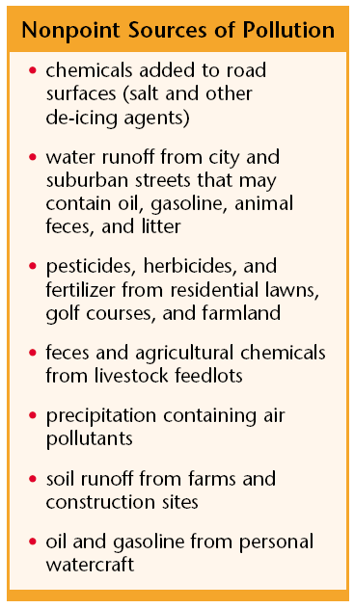
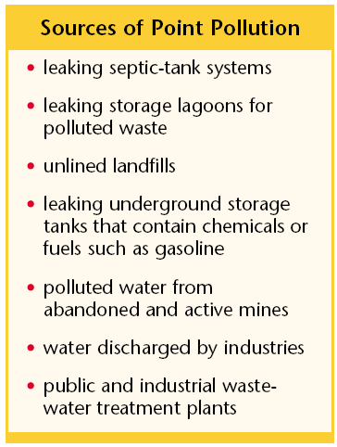
Point and Nonpoint Sources of Pollution
Section 3 Water Pollution

Slide 28
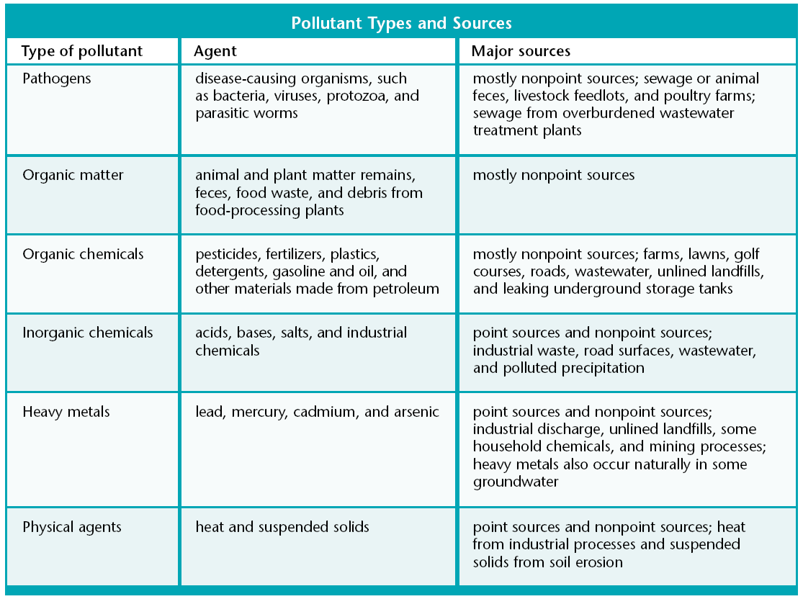
Principal Water Pollutants
Section 3 Water Pollution

Slide 29
Wastewater
Section 3 Water Pollution
After water flows down the drain in the sink, it usually flows through a series of sewage pipes that carry it, along with all the other wastewater in your community, to a wastewater treatment plant.
Wastewater is water that contains wastes from homes or industry.
At a wastewater treatment plant, water is filtered and treated to make the water clean enough to return to a river or lake.

Slide 30
Treating Wastewater
Section 3 Water Pollution
Most of the wastewater from homes contains biodegradable material that can be broken down by living organisms.
For example, wastewater from toilets and kitchen sinks contains animal and plant wastes, paper, and soap, all of which are biodegradable.
But, some household and industrial water and some storm-water runoff contains toxic substances that cannot be removed by the standard treatment.

Slide 31
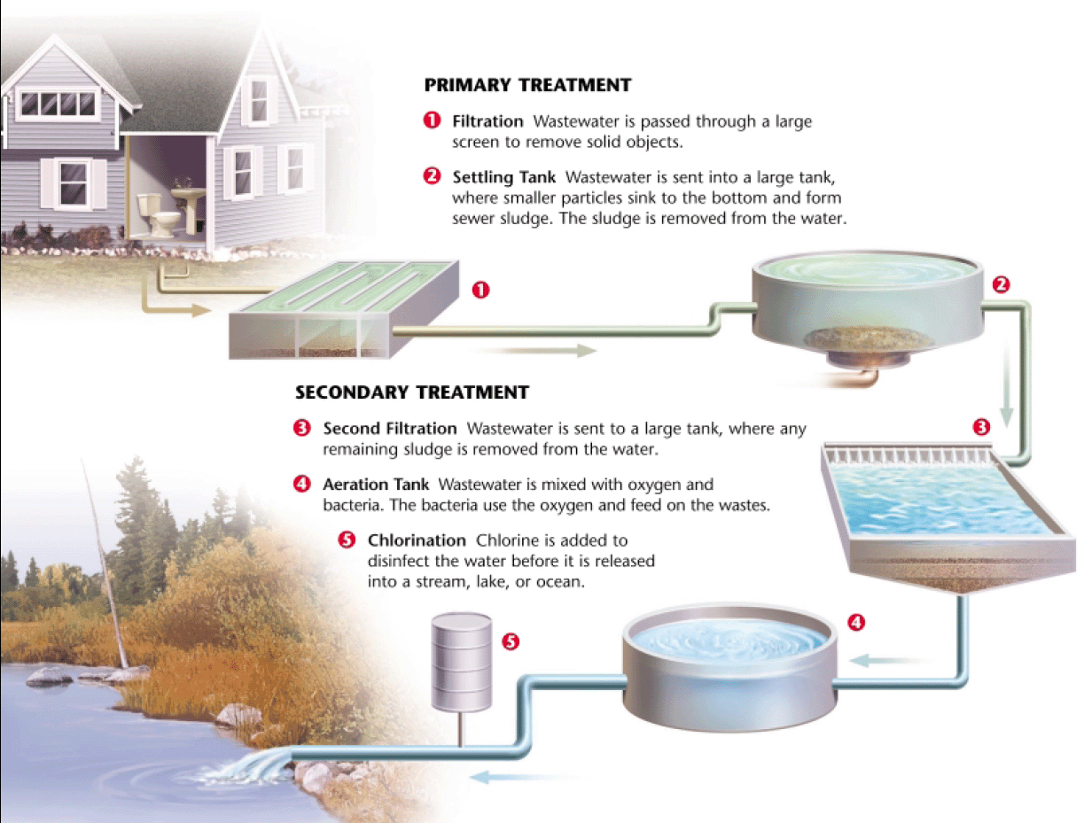
Wastewater Treatment Process
Section 3 Water Pollution

Slide 32
Sewage Sludge
Section 3 Water Pollution
One of the products of wastewater treatment is sewage sludge, the solid material that remains after treatment.
When sludge contains dangerous concentrations of toxic chemicals, it must be disposed of as hazardous waste. It is often incinerated, and then the ash is buried in a secure landfill.
Sludge can be an expensive burden to cities as the volume of sludge that has to be disposed of every year is enormous.

Slide 33
Sewage Sludge
Section 3 Water Pollution
The problem of sewage sludge disposal has prompted many communities to look for new uses for this waste.
If the toxicity of sludge can be reduced to safe levels, it can be used as a fertilizer.
In another process, sludge is combined with clay to make bricks that can be used in buildings.

Slide 34
Artificial Eutrophication
Section 3 Water Pollution
Most nutrients in water come from organic matter, such as leaves and animal waste, that is broken down into mineral nutrients by decomposers such as bacteria and fungi.
Nutrients are an essential part of any aquatic ecosystem, but when lakes and slow-moving streams contain an abundance of nutrients, they are eutrophic.

Slide 35
Artificial Eutrophication
Section 3 Water Pollution
Eutrophication is a natural process
When organic matter builds up in a body of water, it will begin to decay and decompose. The process of decomposition uses up oxygen, and as oxygen levels decrease, the types of organisms that live in the water change over time.
For example, plants take root in the nutrient rich soil, and as more plants grow,the shallow waters begin to fill in. Eventually the body of water becomes a swamp or marsh.

Slide 36
Artificial Eutrophication
Section 3 Water Pollution
The natural process of eutrophication is accelerated when inorganic plant nutrients, such as phosphorus and nitrogen, enter the water from sewage and fertilizer runoff.
Artificial eutrophication is a process that increases the amount of nutrients in a body of water through human activities, such as waste disposal and land drainage.
The major causes of eutrophication are fertilizer and phosphates in some laundry detergents.

Slide 37
Artificial Eutrophication
Section 3 Water Pollution
Phosphorus is a plant nutrient that can cause the excessive growth of algae.
In bodies of water polluted by phosphorus, algae can form large floating mats, called algal blooms.
As the algae die and decompose, most of the dissolved oxygen is used and fish and other organisms suffocate in the oxygen-depleted water.

Slide 38
Thermal Pollution
Section 3 Water Pollution
Thermal pollution is a temperature increase in a body of water that is caused by human activity and that has harmful effect on water quality and on the ability of that body of water to support life.
Thermal pollution can occur when power plants and other industries use water in their cooling systems and then discharge the warm water into a lake or river.

Slide 39
Thermal Pollution
Section 3 Water Pollution
Thermal pollution can cause large fish kills if the discharged water is too warm for the fish to survive.
If the temperature of a body of water rises even a few degrees, the amount of oxygen the water can hold decreases significantly. As oxygen levels drop, aquatic organisms may suffocate and die.
If the flow of warm water into a lake or stream is constant, it may cause the total disruption of an aquatic ecosystem.

Slide 40
Section 3 Water Pollution
Pollutants usually enter groundwater when polluted surface water percolates down from the Earth’s surface.
Any pollution of the surface water in an area can affect the groundwater.
Pesticides, herbicides, chemical fertilizer, and petroleum products are common groundwater pollutants. Other sources of pollution include septic tanks, unlined landfills, and industrial wastewater lagoons.

Slide 41
Groundwater Pollution
Section 3 Water Pollution
Leaking underground storage tanks are another major source of groundwater pollution because as they age, they may develop leaks that allow pollutants to seep in to the groundwater.
Leaking tanks often cannot be repaired or replaced until after they have leaked enough pollutants to be located.
Modern storage tanks are contained in concrete and have many other features to prevent leaks.

Slide 42
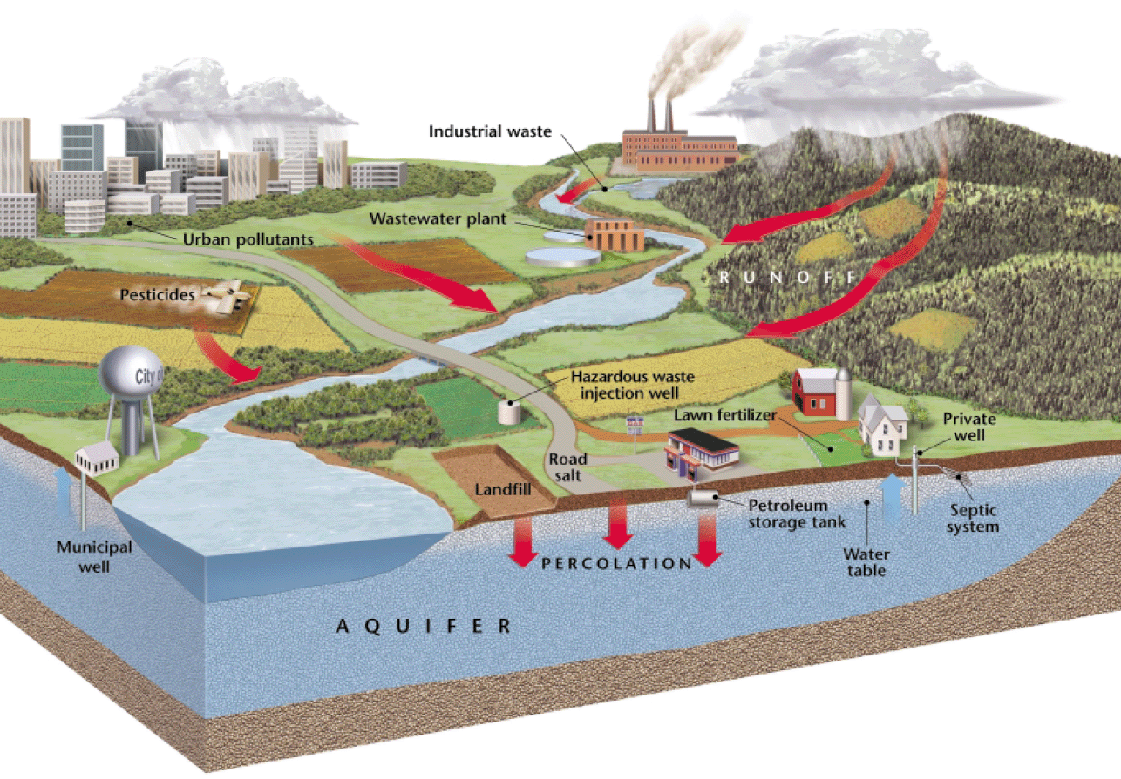
Groundwater Pollution
Section 3 Water Pollution

Slide 43
Cleaning Up Groundwater Pollution
Section 3 Water Pollution
Groundwater pollution is one of the most challenging environmental problems in the world.

Slide 44
Groundwater recharges very slowly, so the process for some aquifers to recycle water and purge contaminants can take hundreds of years.

Slide 45
Also, pollution can cling to the materials that make up an aquifer, so even if all of the water in aquifer were pumped out and replaced with clean water, the groundwater could still become polluted.

Slide 46
Ocean Pollution
Section 3 Water Pollution
Pollutants are often dumped directly into the ocean. For example, ships can legally dump wastewater and garbage overboard in some parts of the ocean.
But at least 85 percent of ocean pollution, including pollutants such as oil, toxic wastes, and medical wastes, comes from activities on land, near the coasts.
Sensitive coastal ecosystems, such as coral reefs, are the most effected by pollution.

Slide 47
Oil Spills
Section 3 Water Pollution
Ocean water is also polluted by accidental oil spills. Each year, about 37 million gallons of oil from tanker accidents are spilled into the ocean.
Such oil spills have dramatic effects, but they are responsible for only about 5 percent of oil pollution in the oceans. Most of the oil that pollutes the oceans comes from cities and towns.
Limiting these nonpoint-sources of pollution would go a long way toward keeping the oceans clean.

Slide 48
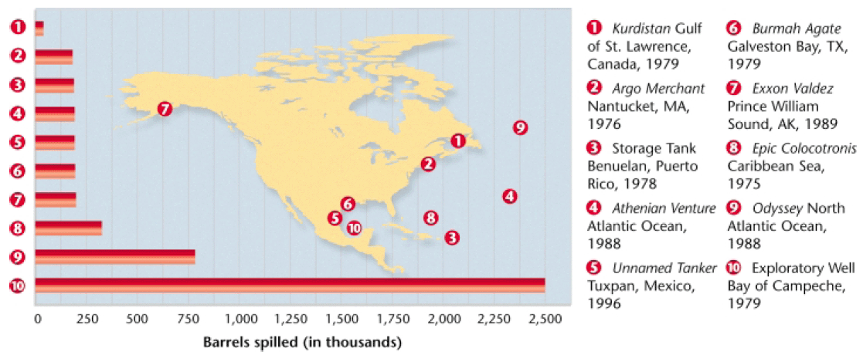
Oil Spills
Section 3 Water Pollution

Slide 49
Water Pollution and Ecosystems
Section 3 Water Pollution
Water pollution can cause immediate damage to an ecosystem, but the effects can be far reaching as some pollutants build up in the environment because they do not decompose quickly.
Biomagnification is the accumulation of pollutants at successive levels of the food chain.
Biomagnification has alarming consequences for organisms at the top of the food chain, and is one reason why U.S. states limit the amount of fish people can eat from certain bodies of water.

Slide 50
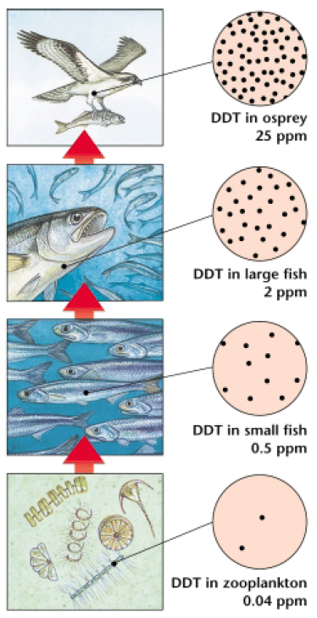
Water Pollution and Ecosystems
Section 3 Water Pollution

Slide 51
Cleaning Up Water Pollution
Section 3 Water Pollution
The Clean Water Act of 1972 was to designed to “restore and maintain the chemical, physical, and biological integrity of the nation’s waters.”
The goal of making all all surface water clean enough for fishing and swimming by 1983 was never achieved, but much progress has been made since the act was passed.
The percentage of lakes that are fit for swimming has increased by 30 percent, and many states have passed stricter water-quality standards.

Slide 52
Cleaning Up Water Pollution
Section 3 Water Pollution
The Clean Water Act opened the door for other water-quality legislation.
For example, the Marine, Protection, Research, and Sanctuaries Act of 1972 strengthened the laws against ocean dumping.
Also, the Oil Pollution Act of 1990 requires all oil tankers traveling in U.S. waters to have double hulls by 2015 as an added protection against oil spills

Slide 53
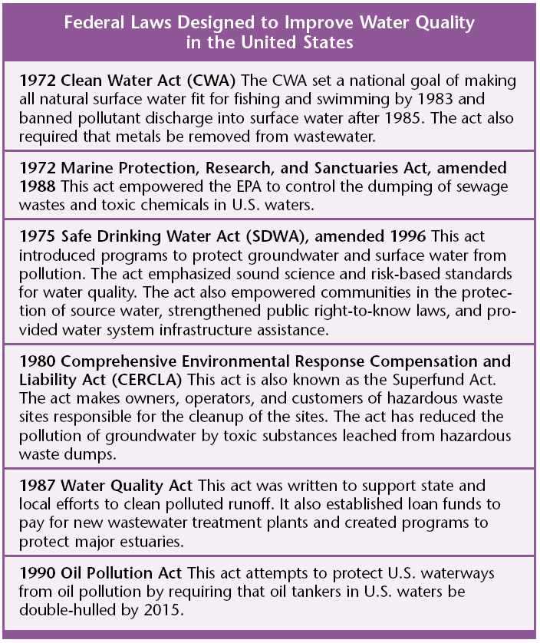
Cleaning Up Water Pollution
Section 3 Water Pollution

